Slide 1

Vitrification in ART
Dr Mohamed Danfour
Consultant Embryologist
Lamis Centre for Diagnosis and Treatment of Infertility
Misurata - Libya

Slide 2
Two techniques were developed
1 Cryopreservation
(Controlled, slow freezing (Whittingham et al., 1972)
2 Vitrification
Ultra-rapid freezing procedure (Rall & Fahy, 1985)

Slide 3
The first successful pregnancy resulting from the transfer of a human embryo that had been cryopreserved by slow cooling was reported in 1983 (Trounson and Mohr, 1983).
Today, IVF programmes routinely use embryo vitrification to augment cumulative pregnancy rates from a single oocyte retrieval, which rapidly becoming the method of choice (Vajta and Kuwayama, 2006).

Slide 4
cryopreservation

Slide 5
Steps of Cryopreservation
Equilibration in the cryoprotectant
Freezing process
Storage in LN₂
Thawing (warming) process
Removal of the cryoprotectant
Culture in the physiological medium

Slide 6
Factors influencing the success of cryopreservation
Possible temperature shocks (+ 15°C or -5°C)
Possible changes in the plasma membrane
Selection of the right cryoprotectant
Dehydration: intensity and time
Critical cell volume
Solute concentration
Cooling rate
Thawing rate

Slide 7
Temperature shock
This happened if the cells cooled too fast
(also without ice crystalization)
This shock starts at the plasma membrane due to:
* Shrinkage of the different parts of the membrane
* Mechanical effect
* Reduction of the volume

Slide 8

Characteristics of cryoprotectants
High soluble in water
Relative low molecular weight
Fast cell permeability
Conjunction with water to built stable H₂ bridges
With high concentration should be non-toxic
Reducing the freezing point of the extracellular fluid
Low influx of the intracellular water to avoid the sudden shrinkage of the cell.

Slide 9
Cryoprotectants
Permeable | Non permeable
Methanol CH₃OH | Polyethylenglycol
Ethanol C₂H₅OH | Polyvinyl pyrrolidone
Ethylenglycol C₂H₄(OH)₂ | Ficoll
1-2 Isopropanol C₃H₆(OH)₂ | Sucrose
Glycerol C₃H₅(OH)₂
DMSO (CH₃) SO

Slide 10

Cryprotectant concentration and solute concentration during freezing (exp. DMSO)
Isotonic saline solution (9g NaCl/Liter)
replaced by replaced by replaced by
1% DMSO 5% DMSO 10%DMSO
It will reach a concentration of 50g/Liter by
-5°C -20°C -50°C

Slide 11
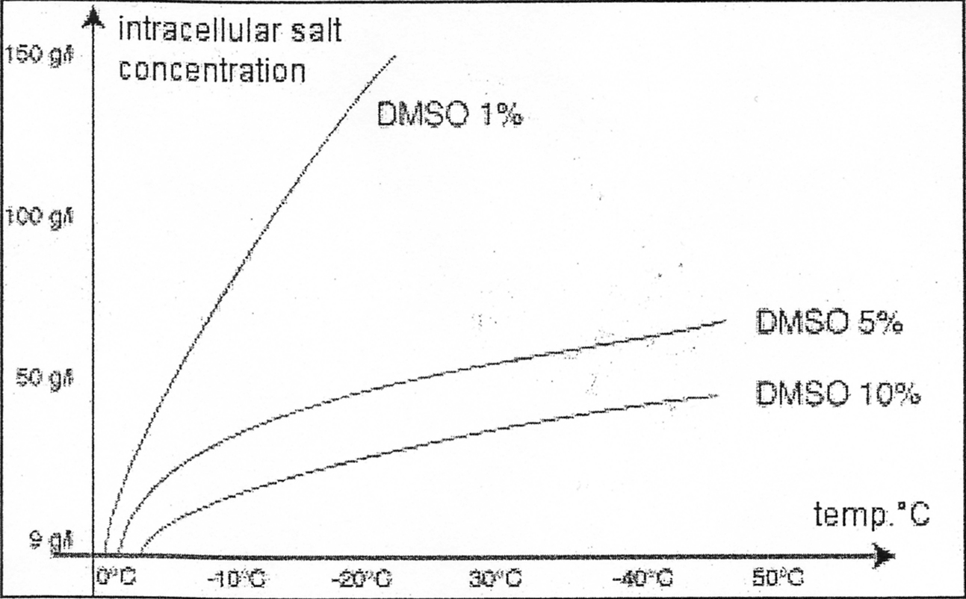
DMSO concentration and solute concentration during freezing

Slide 12
Action of the cryoprotectant
Penetration of cryoprotectant in the cell and
partially replacing the
↓
intracellular water
↓
dehydration of the cell

Slide 13
Cooling rate
Avoiding temperature shock
Avoiding damage effect of the cell during dehydration
Avoiding damage of the colloidal milieu of the cell

Slide 14
Cooling rate
Optimal cooling rate,
if the cell gives the maximum
amount of the intracellular water to avoid the intracellular ice crystal formation

Slide 15
Cooling rate
Optimal cooling rate is dependent on the critical volume of the cell which can be defined as:
The permeability of the cell membrane to the water
Large membrane surface
The relation between cell surface to the cell volume according
to these phenomenon each cell has its cool rate

Slide 16
Thawing rate
The thawing rate is closely related to the cooling rate in general: the fast thawing is preferable
Thawing rate has no influence to the slow freezing

Slide 17
The most important principle of the cryopreservation
of the oocytes and embryos is:
The formation of ice crystals which should be avoided
during the process of freezing of the cells and tissues

Slide 18
vitrification in ART
Physical definition:
Vitrification is solidification of a solution to be similar to the state of the glass

Slide 19
Vitrification is a process in which liquids solidify without crystallization (Luyet, 1937).
Compared with the slow cooling procedures, vitrification methods are very rapid.

Slide 20
Three key factors influence the probability of successful vitrification (Rios et al., 2010):
* Cooling and warming rates
* Composition of the cryoprotectant solution which is
reflected in the viscosity of the sample
* Sample volume.

Slide 21
Increasing the cooling/warming rate (Vajta and Kuwayama, 2006), raising the cryoprotectant content or decreasing the sample volume will each increase the probability of vitrification (Arav, 1992).
In the past, vitrification was achieved by simply plunging the sample into liquid nitrogen (LN) at -196°C (Rall and Fahy, 1985).
During this process, heat transfer from the sample into the LN leads to the evaporation of LN around the sample, resulting in the formation of a nitrogen gas layer, which acts as an insulator.

Slide 22
Main principles of the vitrification in ART:
Guarantee of fertilization (oocyte)
High survival rate after warming
Increasing the success rate through a significant
High cumulative pregnancy rate

Slide 23
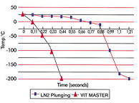
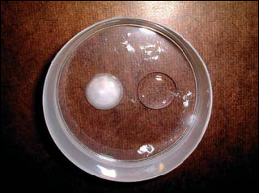
Freezing in the liquid nitrogen LN₂
(Vitrification)
Physical definition:
solidification of a solution to be similar to the state of the glass

Slide 24
Vitrification vs Cryopreservation
37°C
Vitrification
Cryopreservation
Slow freezing
(equilibrated)
H₂O
total dehydratation
-5
Room
temperature
H₂O
0.3 – 0.5°C/min
> 25000°C/min
-35
Temp Degrees C
weak dehydratation
-80
Weak dehydratation
-196
Storage
Storage
Storage
10
20
30
Temps (min)

Slide 25
Cryopreservation vs. Vitrification
 | Cryopreservation | Vitrification
CPA-Concentration | 1.5 M | 3.0- 5.0 M
Volume | 0.3-1.0 ml | < 1 µl
Contact with N₂ & the cell | no | yes
Cooling rate | ~ 0.5°C /min | 15.000- 50.000 °C/min
Freezing | slow | ultrarapid
Thawing/ Warming | slow | rapid
Time consuming | ≥ 180 min. | 2 sec.
Dehydration | not controlled | controlled

Slide 26
Terminology
Instead of Freezing → Vitrification
Instead of Thawing → Warming

Slide 27
Why we prefer the vitrification-procedure now ?
There is no mechanical injury (extracellular crystal formation)
Less osmotic stress for the cell
No intracellular crystal formation
Less labor in the laboratory daily work
Simple protocol
It is useful for cells like oocytes and blastocyst which have less success with slow freezing
No need for expensive device

Slide 28
Cooling rate and Vitrification (importance)
High cooling rate needs high concentration of cryoprotectants
There is a practical limit to achieve high cooling rate which correlates with biological limit of the cryoprotectant of cells during vitrification
For this reason it is important to find a balance between a maximum cooling rate and a minimum concentration of cryoprotectant.

Slide 29
Example for cooling rates
~ 2500°C/ min by using 0.25 ml straws. Thick straw and large volume of medium do not allow a high cooling rate and thawing rate
~20000-25000°C/min by using a carrier which allows a very small volume which can get a direct contact with LN₂

Slide 30
Cell carrier systems
Open- pulled straws (OPS) Kuleshova et al. 1999; Chem et al. 2000
Electron microscope copper grid Hong et al. 1999, Park et al. 2000
French ministraws Vanderzwalmen et al. 2002
Flexipet-denuding pipette (FDP) Liebermann et al. 2002
Cryo loop (CL) Reed et al. 2002
Hemi-straw system (HSS) or Cryotop also Stehlik et al. 2003

Slide 31
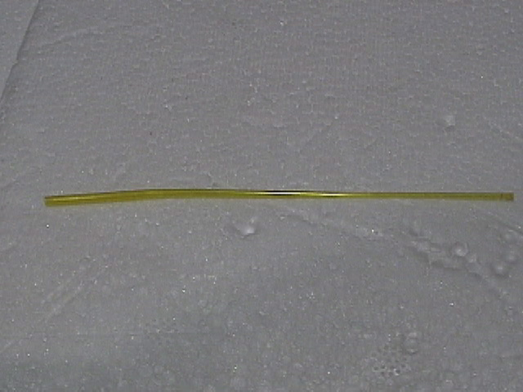
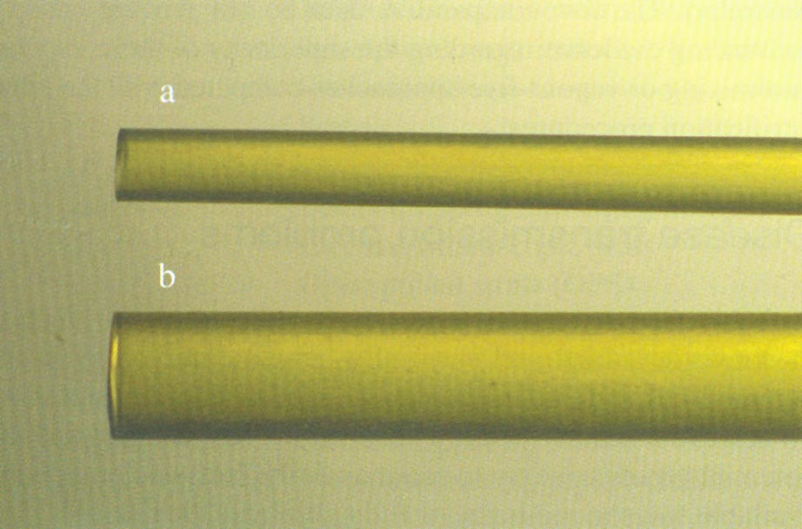
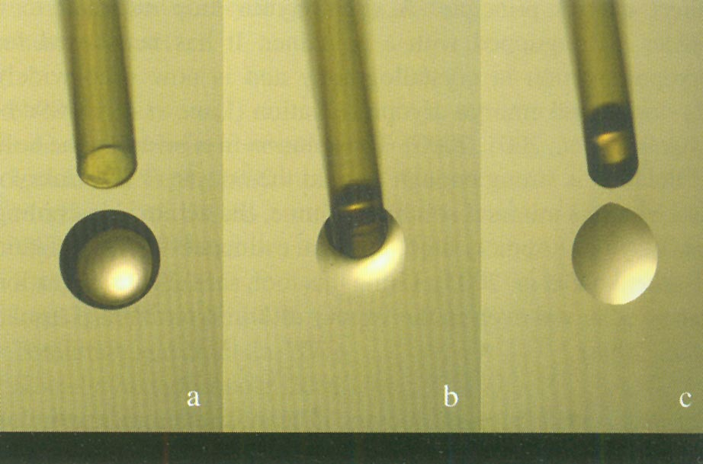
Open- Pulled straws (OPS)

Slide 32
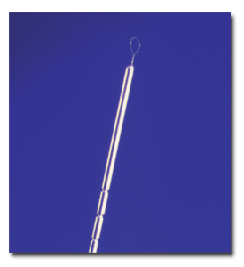
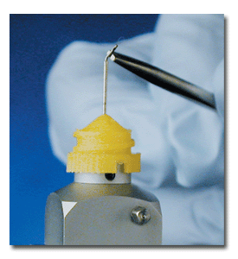

Cryoloop

Slide 33
Cryotop

Slide 34
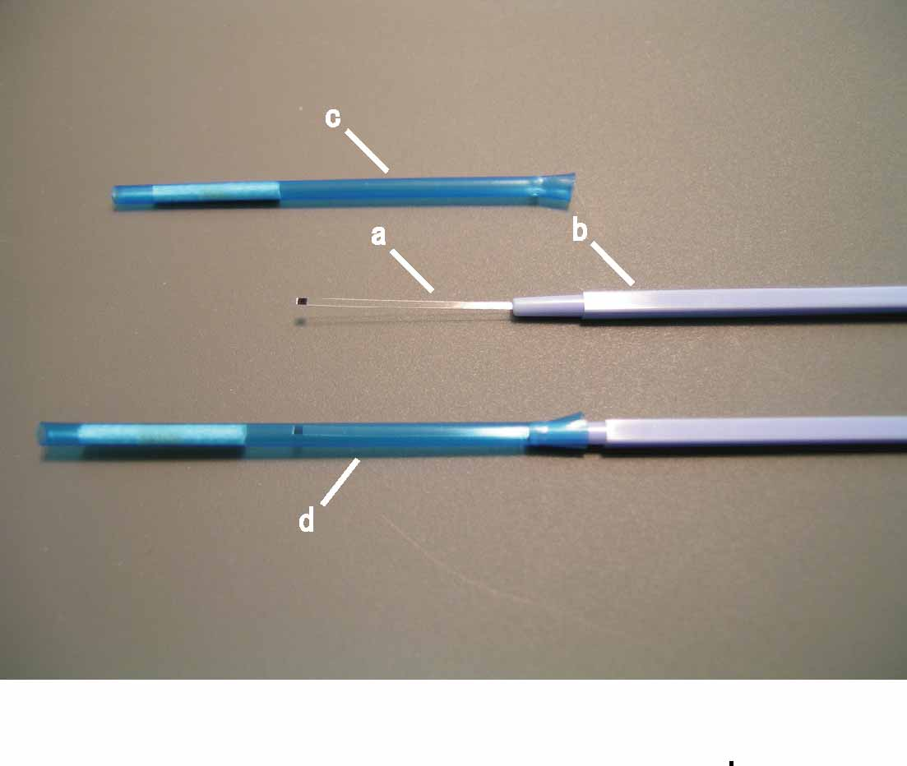
Ultra-rapid Vitrification container: Cryotop
a: Transparent fine
Polypropylene sheet (0.8mm x 2cm)
b: Plastic handle
c: Cover cap
d: Cover Top part during
storage in LN2

Slide 35
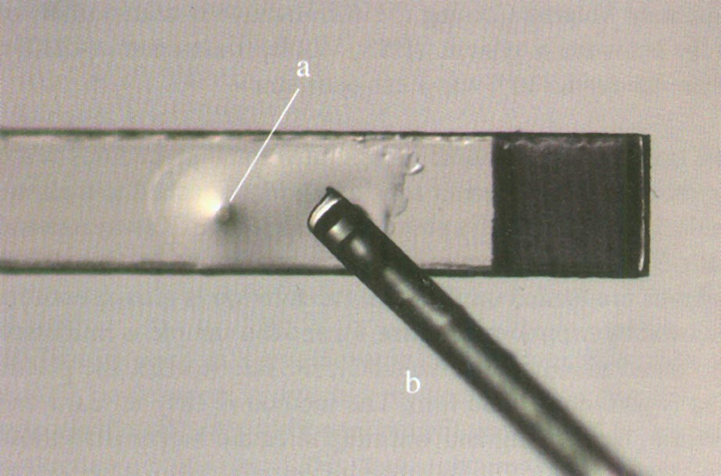
Cryotop

Slide 36
Cryotip

Slide 37
Cryoleaf (McGill)

Slide 38
Critical side of Vitrification
Very high cooling rate
Protection against potentially toxic chemicals
(Vitrification needs high concentration of permeable cryoprotectant to induce a intracellular vitrification)
(which is sometimes biologically and technically difficult and problematic)
There is a direct contact between the vitrification medium and LN₂ which is eventually a source of contamination.

Slide 39
Solution for Vitrification
To reach a high cooling rate, special container or carrier should be used
To minimize the toxicity of the cryoprotectant, at least two different types of cryoprotectant should be used in a stepwise incubation and two different concentration (lower-strength and full-strength)
LN₂ as a source of contamination ?

Slide 40
Contamination during LN₂ storage
Virus and bacteria can survive the LN₂ at -196°C like Hepatitis- and HIV-virus ?
Extra tank for vitrified material
Infected material should not be frozen

Slide 41
Yavin etal 2009
Yavin etal 2009 describe an innovative method; ‘sealed pulled straws’ (SPS), which is designed to reduce the potential risk of contamination during vitrification while maintaining a high cooling rate in LN slush at -210°C.
This method protects the biological sample from direct contact with the LN during the vitrification process and subsequent storage.

Slide 42
What are the different solutions for vitrification ?
Permeable cryoprotectant for the cell membranes (Glycerol, Ethylenglycol, DMSO)
Non- permeable cryoprotectant
(Sugar, Proteines, Polymere)

Slide 43
What are the characteristics of the vitrification solutions
Essential substances: permeable cryoprotectant
The solution should have the power for dehydration
The possibility to reduce the freezing point
These cryoprotectants should be non-toxic
Non-permeable substances ( Sucrose, Trehalose)
Dehydration of the cell through osmosis
Reduction of the swelling shock during rewarming
Support the process of dehydration through reduction of the
incubation time
The sucrose leads to increase of the viscosity of the solution

Slide 44
Equilibration in the protective substance
Time
The incubation should be short as possible
Two-step equilibration is important to reduce the toxicity
Temperature
The fast entrance and the degree of toxicity of the cryoprotectant can be influenced by temperature
Equiliberation at 37°C avoid the re-expansion of the cell especially the first step of warming
It is advisable to equilibrate between 22 and 25°C

Slide 45
Is the technique of vitrification standarized to be adopted in IVF-centers?
All the developmental stages are now vitrified sucessfully
These are some technical difficulties…….
a- Type and concentration of the cryoprotectant
b- Variability in the volume of the media or the carrier
c- Temperature of the solution during equilibration
d- Type of vitrification container
e- Skillness of the embryologist

Slide 46
Successful vitrification
High cooling rate ( >25.000 °C)
Fast cooling period (< 2 sec.)
Low volume ( < 1µl)
This will lead to avoid crystal formation

Slide 47
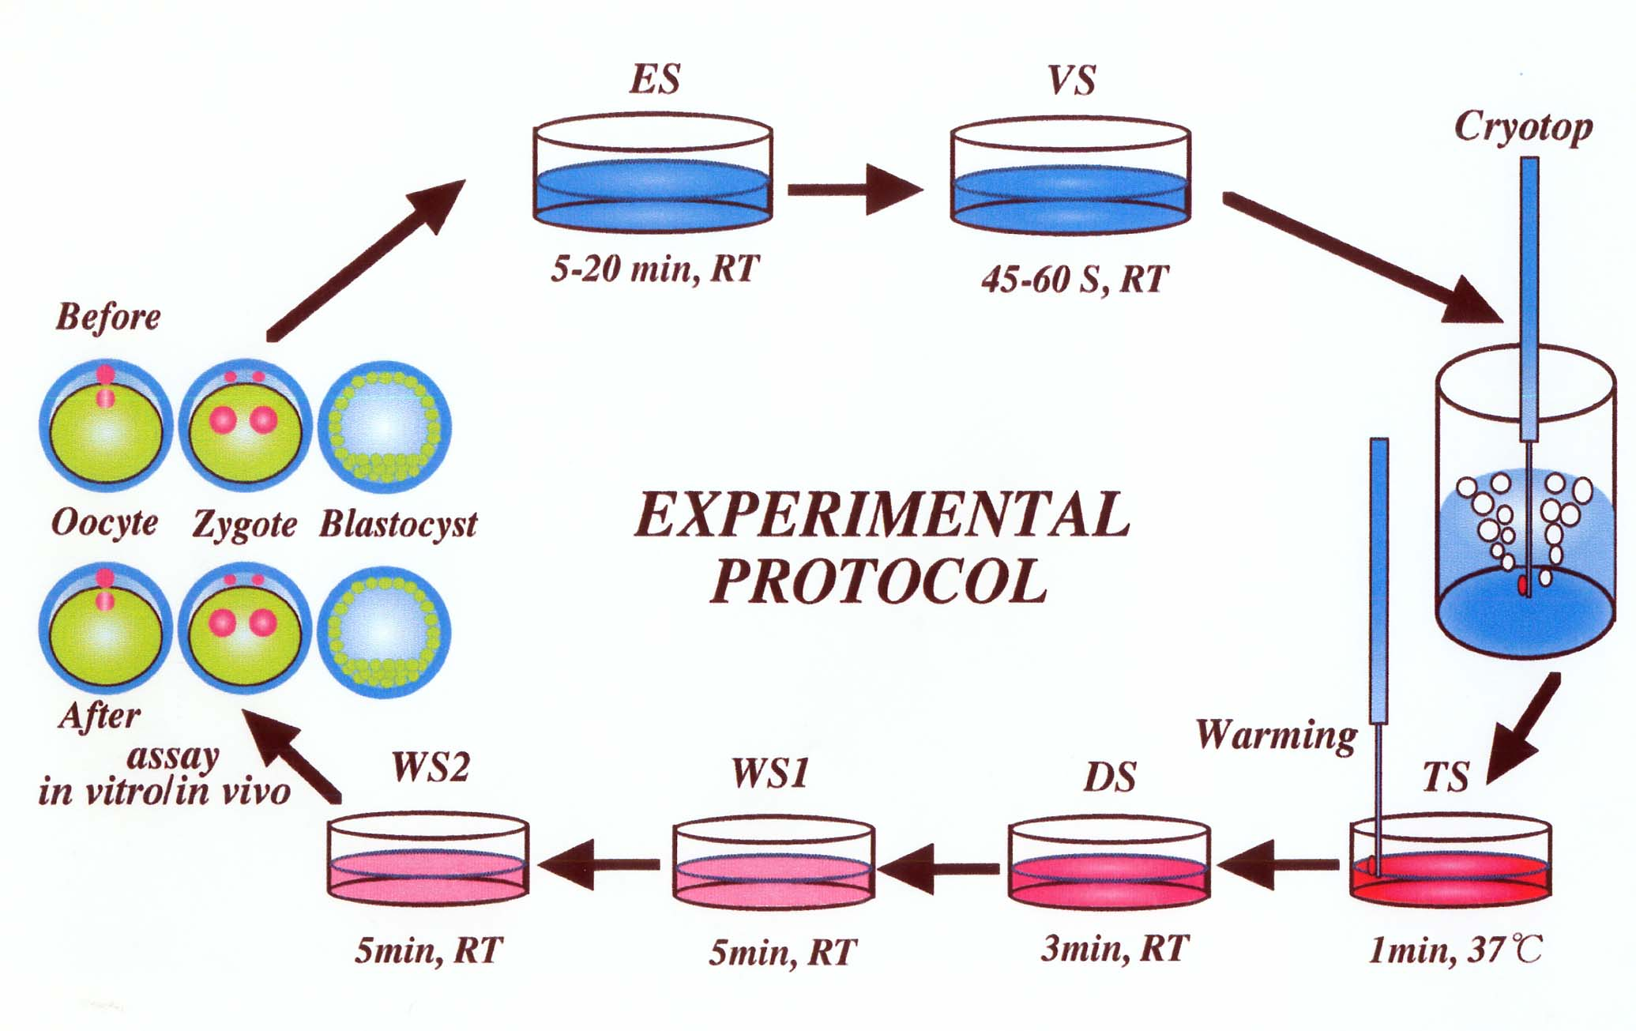

Slide 48
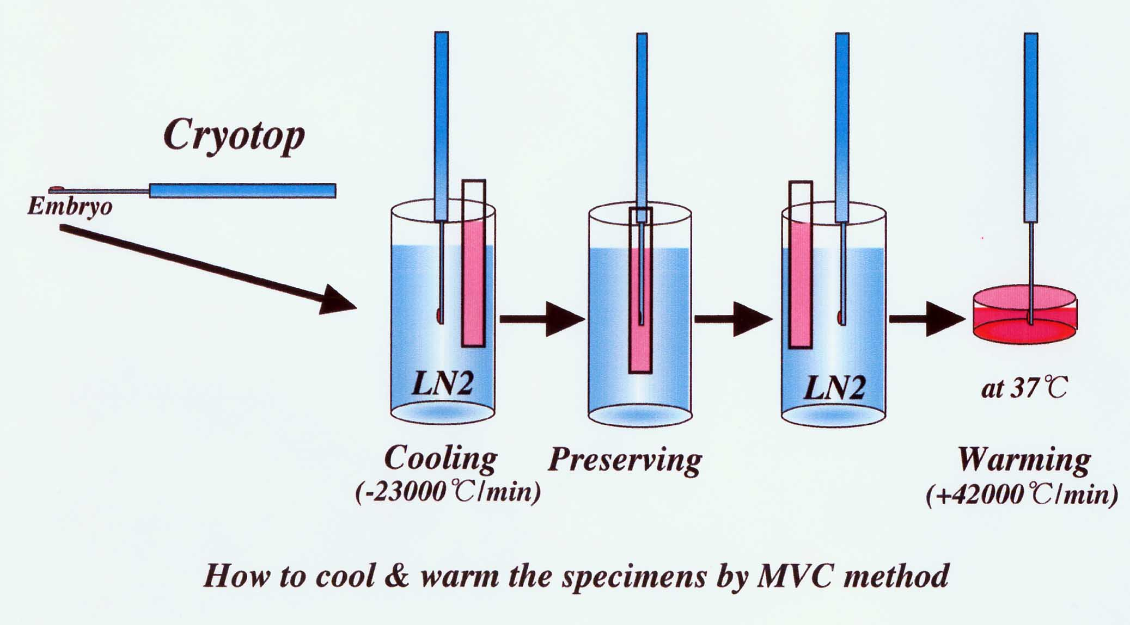

Slide 49
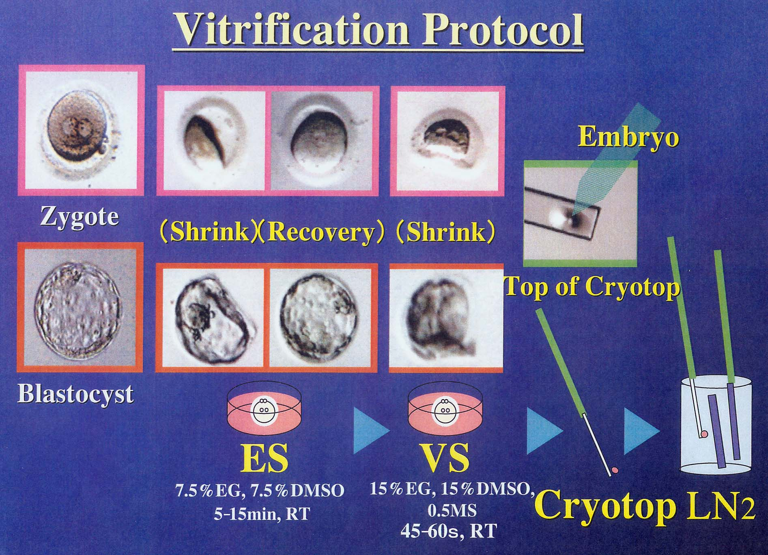

Slide 50
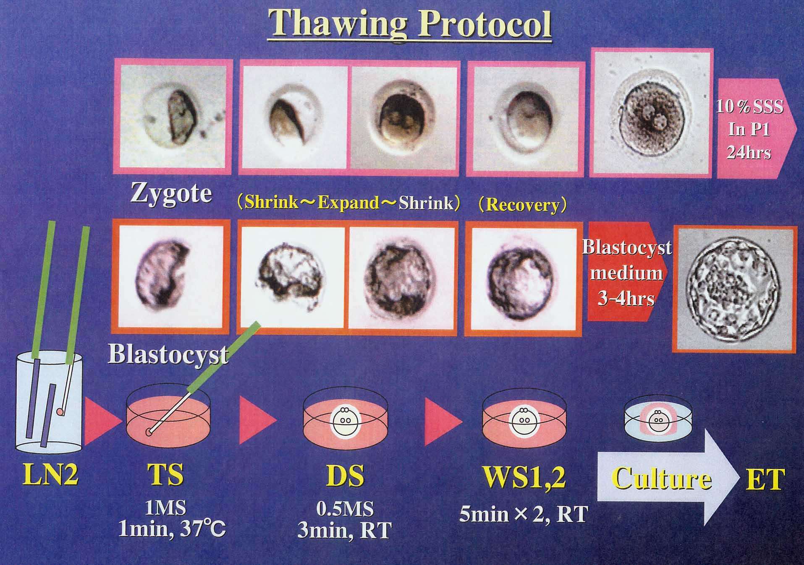

Slide 51
Vitrification
3min
3min
9min
15sec x 4
Cryotop
WS + ES1 + ES2
ES3
VS1 VS2 VS3 VS4
(20μl for each drop, at R.T.)
(7.5%EG,7.5%DMSO in ES)
(15%EG,15%DMSO,0.5M Suc in VS)
LN2
Thawing
(1M Suc in TS, 0.5M Suc in DS)
TS
DS
WS1,2
P1 2hrs
1min, 37℃
3min
5min×2
Before ICSI

Slide 52
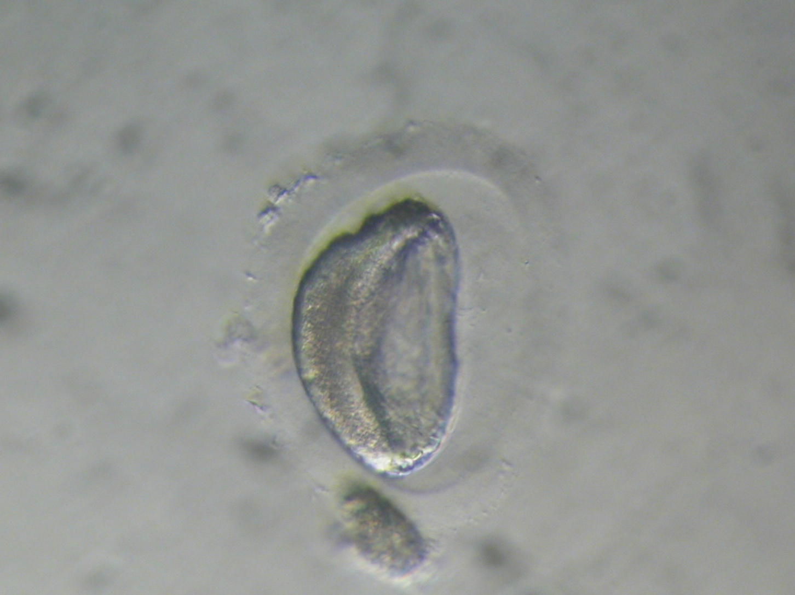

Slide 53
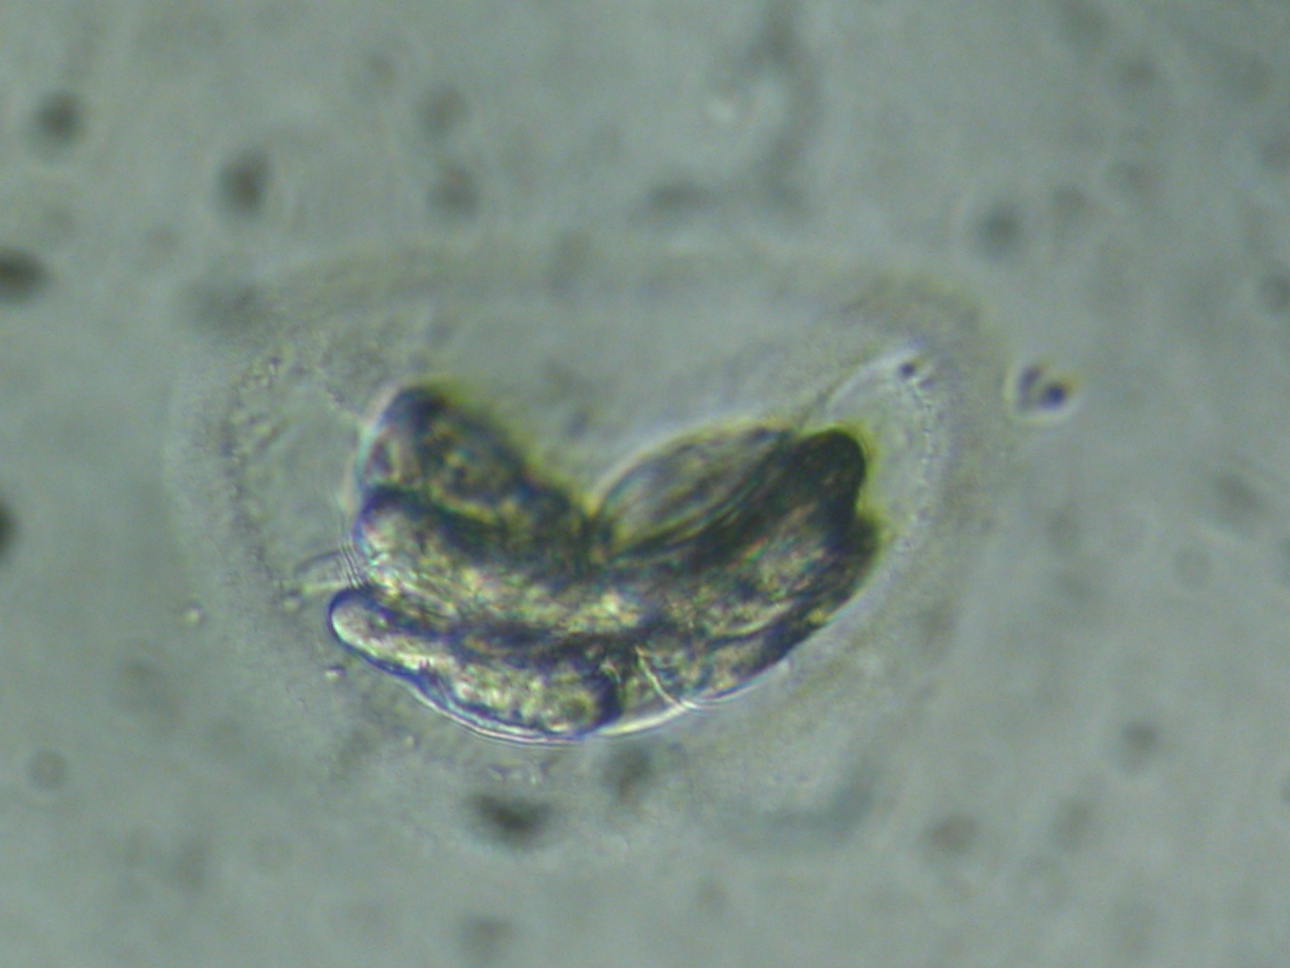

Slide 54
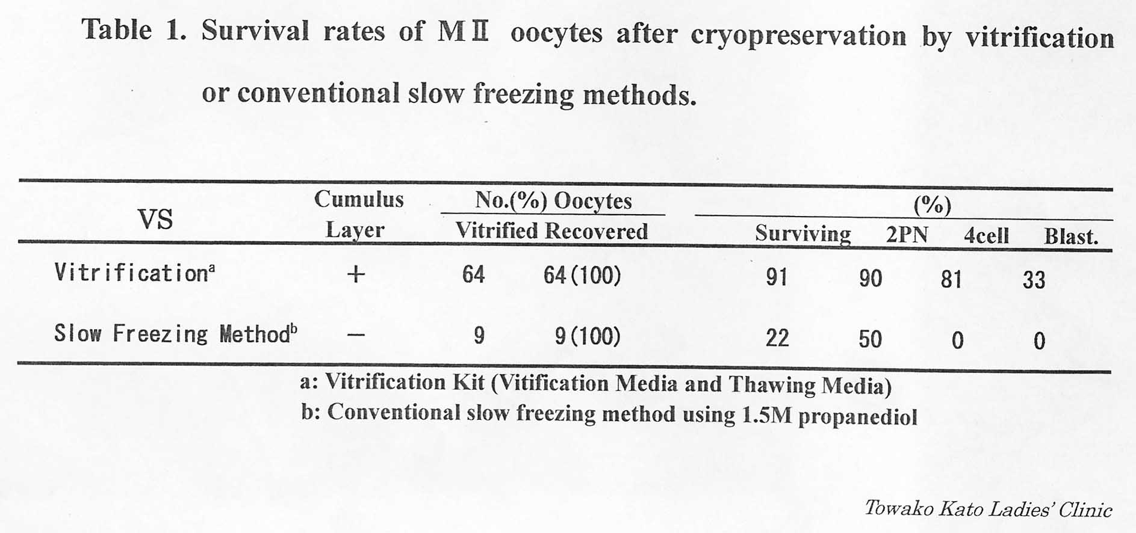

Slide 55
Kuwayama et al. 2005, RBM online, 11, 300-308
No. of oocytes | No. (%) of survived | No. (%) of fertilization | No. (%) of blastocyst | No. of embryos transferred | No. of pregn. | No. of birth | No. of ongoing
64 | 58 (91) | 52 (89.6) | 32 (50) | 29 (22) | 12 | 7 | 3

Slide 56
Results of vitrified Human Oocytes
No. Of Cycles 120
No. Of Occytes vitrified 463
No. Of Oocytes warmed 330
No. & % survived 328 (99.4)
No. & % cleaved 295 (96.7)
Implantation rate 13.2%
No. & % clinical preg. 39 (32.5)
No. & % abortions 8 (20.5)
No. Of deliveries 3
        M. Antinori et al. 2007
        RBM online 1, 14

Slide 57
Vitrification of human 8-cell embryos, a modified protocol for better pregnancy rates
Dr. Raju (2005)
 | Vitrifi. | slow-freezing
No. of embryos No. of thawed No. & % survived No. & % pregnant | 436 127 121 (95.3) 14 (35) | 420 120 72 (60) 4 (17.4)
40% EG + 0.6 mol sucrose, nylon loop
Statement: EG is a good croyprotectant to preserve 8-cell embryos because of its low toxicity as shown by the high survival rate, and vitrification is a promising alternate to the conventional slow-freezing method.
RBM online, 11, 434-437

Slide 58
Vitrification demonstrates significant improvement versus slow-freezing of human blastocysts
Stehlik et al. (2005)
Day 5 Day 6
 | slow | Vitr. | slow | Vitr.
No. of embryos transferrerd % of survival % pregnant | 24 83 16.7 | 20 100 50 | 27 89.5 18.5 | 15 100 33.3
Survival & pregnancy rates of day 5 Vit. Blastocysts have significantly increased over day 5 of slow-frozen blastocysts. A similar trend was observed with day 6 blastocysts.
RBM online, 11, 53-57

Slide 59
n=5881
n=897
n=1175
Post-thaw survival rates of human PN zygotes, 4-cells stage embryos and blastocysts after vitrification

Slide 60
Escriba et al., 2009 Fertil Steril
Describe a new methodology for preserving and banking isolated human blastomeres
75.7% After warming, of blastomeres survived and developed at a
rate comparable to that in noncryopreserved blastomeres
62.5% Cleavage
26.6% Compaction
20.3% Cavitation

Slide 61
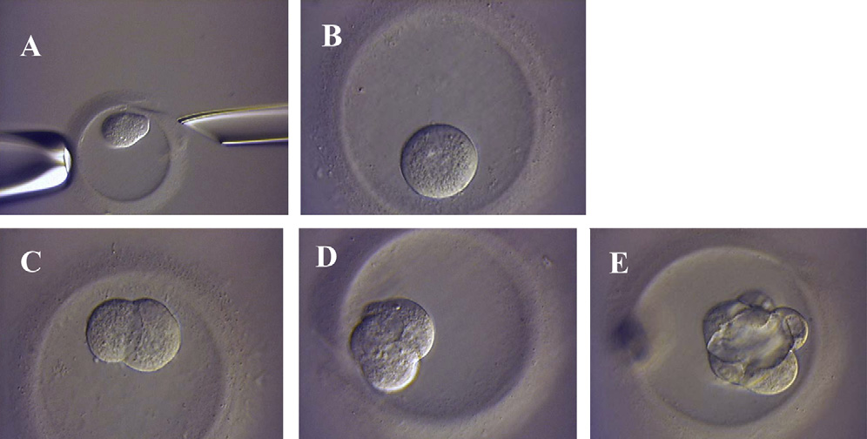
An emptied zona pellucida packed with a single blastomere
Using a biopsy instrument (tool on the right) and a holding pipette (left tool). Blastomere detail at 30 minutes after manipulation
During in vitro culture, some blastomeres cleaved
Compacted
Cavitated (E).

Slide 62
Vitrification of spermatozoa
Spermatozoa cryopreservation empirical methods developed in the 1949 are still used today.
The motility of cryopreserved/thawed spermatozoa normally falls to about 50% of the motility before freezing, wherein inter-individual fluctuation can be considerable.
Despite routine application, the problem of toxicity due to osmotic stress
during saturation and dilution of the cryoprotectant as well as the possible negative influence on the genetic material is as yet unresolved .

Slide 63
Classical vitrification requires a high percentage of permeable cryoprotectants in medium (30-50% compared to 5-7% with slow-freezing) and is unsuitable for the vitrification of spermatozoa due to the lethal osmotic effect.
Shape and size of the sperm head could be factors, which
define the cryosensitivity of the cell.

Slide 64

New Method for Vitrification of Small Volume of Normal Human Sperms: Use of Open Pulled Straw Carrier
Saki etal 2009
Progress motility of sperm in fresh group was evaluated as 59.2±7.6 comparing to
37.5±8.2 Vitrification method
26.3±6.4 Cryopreservation

Slide 65
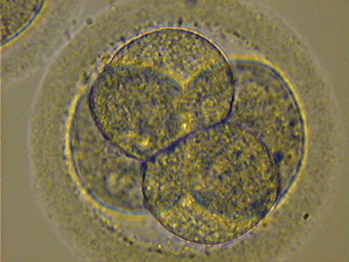

Lamis Infertillity Centre preliminary results 2008-2010
Embryo Vitrification
No. of Cycles | No. of embryo vitrified | No. Of embryo Thawed (cycles) | No. & % Embryo survived | No. & % Continous development
173 | 865 | 282(79) | 282(100%) | 271 (96%)
Four deliveries, 12 biochemical pregnancy

Slide 66
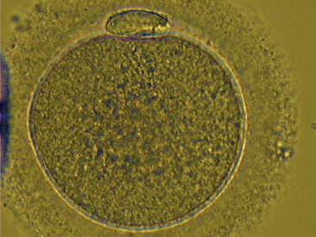

Lamis Infertillity Centre preliminary results 2008-2010
Oocyte Vitrification
No. of Cycles | No. of Oocytes vitrified | No. Of Oocytes Thawed (cycles) | No. & % Oocytes survived | No. & % of 2PN and cleaved
22 | 138 | 32 (6) | 32(100%) | 26 (81%)

Slide 67
Open Questions?????????
1-Toxicity of the Cryoprotactants
2-Type of the Carrier
3-LN2 Contamnination

Slide 68
Future Aspects
In case of OHSS and PCO
All 2PN cryopreservation

Slide 69
Quality is evolution
Vitrification is a revolution
Prof. van der Elst
19.1.2007

Slide 70
Summary
The vitrification procedure is easy to be done
Much less costs
It is the procedure of the first choice in the future
The survival rate is very high with all different stages of development
It may be need to be standardized
It needs skillness of the embryologist

Slide 71
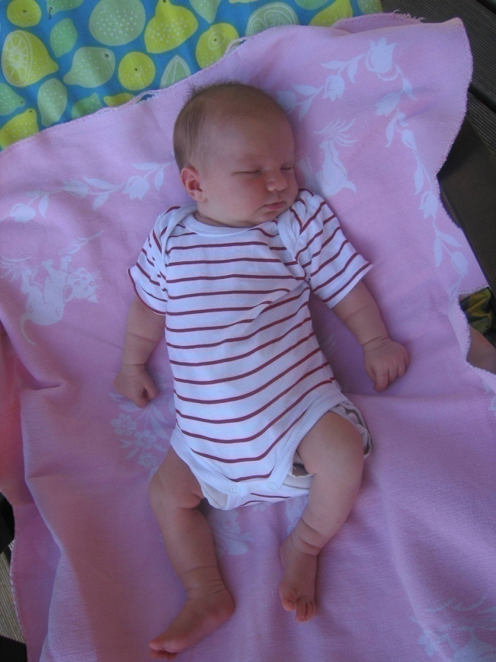
Thank you !

