Slide 1
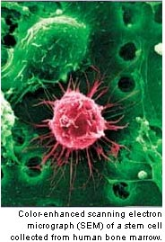
Cord Blood Stem Cells
Marwan Alhalabi MD. PhD
Professor in Faculty of Medicine
Damascus - University
And
Medical Director
Orient Hospital
assisted Reproduction center

Slide 2
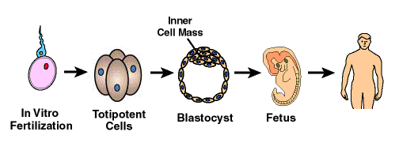
What are Stem Cells?
Cells that have the ability to divide and differentiate into other cell types

Slide 3
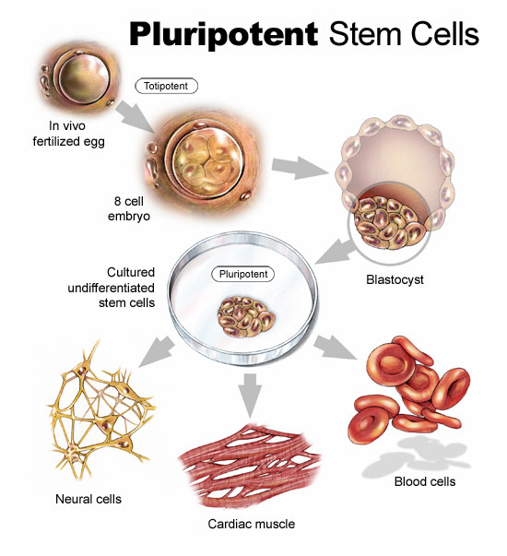
Types of Stem Cells
Embryonic stem cells
Derived from the blastocyst, which is a very young embryo shaped like a hollow sphere that contains 200-250 cells (pre-implantation embryos)¹
Adult stem cells
Misnomer, can be found in children and infants too
Derived from the umbilical cord and placenta, or from blood, bone marrow, skin, or other tissues

Slide 4
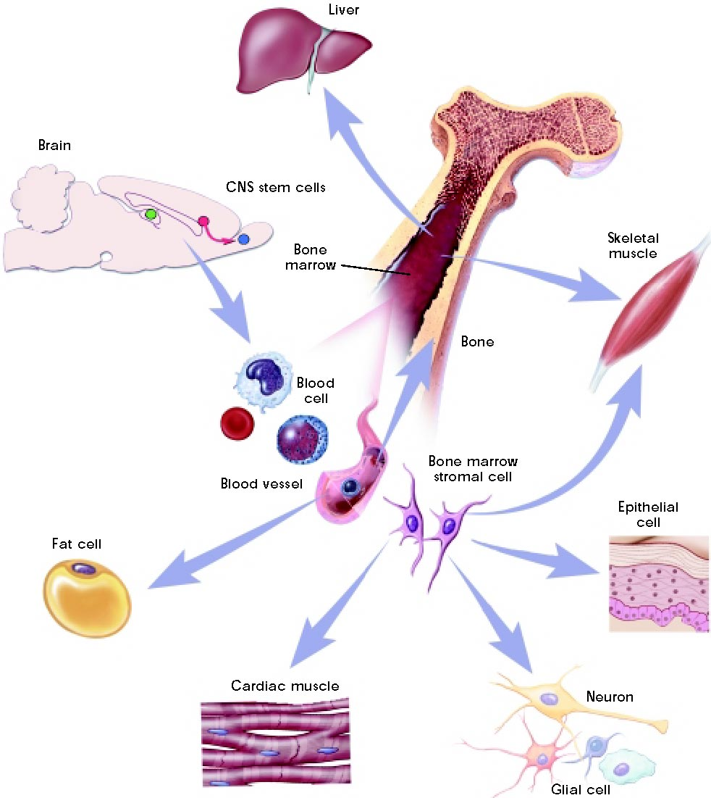
Stem Cell Potency
Differentiation potential
Totipotent
Can be any type of cell in the body
Pluripotent
Can become almost any kind of cell in the body (an example would be fetal cells)
Multipotent
Can differentiate into only a limited range of cell types (examples include umbilical cord and adult stem cells)

Slide 5
Kinds of Stem Cells
Stem cell type | Description | Examples
Totipotent | Each cell can develop into a new individual | Cells from early (1-3 days) embryos
Pluripotent | Cells can form any (over 200) cell types | Some cells of blastocyst (5 to 14 days)
Multipotent | Cells differentiated, but can form a number of other tissues | Fetal tissue, cord blood, and adult stem cells

Slide 6
What makes this cell special ?
Plasticity or ability to differentiate
Ability to divide continuously
Immunological immaturity
“Self renewal”
“Stem cell”
Pluripotency
Differentiation
“Progenitor cell”
“TA cells”
“Differentiated cells”

Slide 7
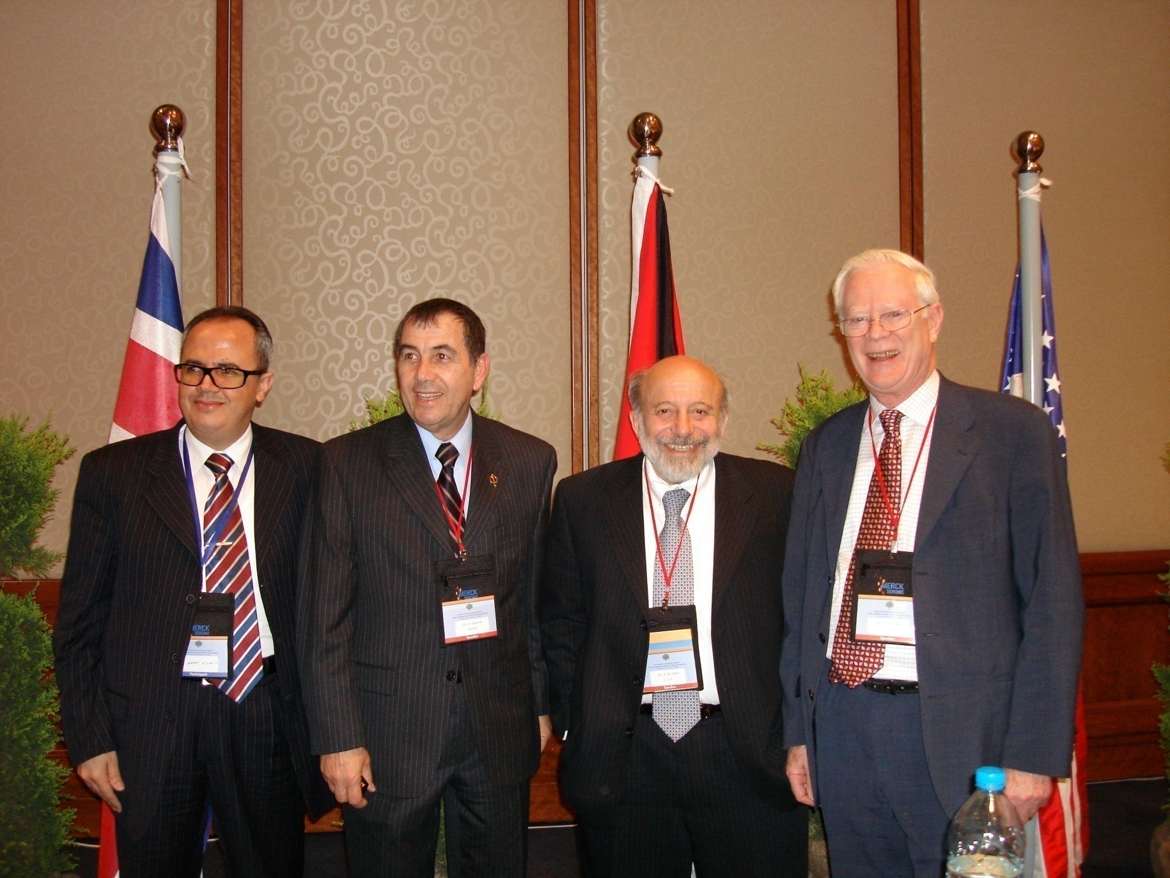

Slide 8
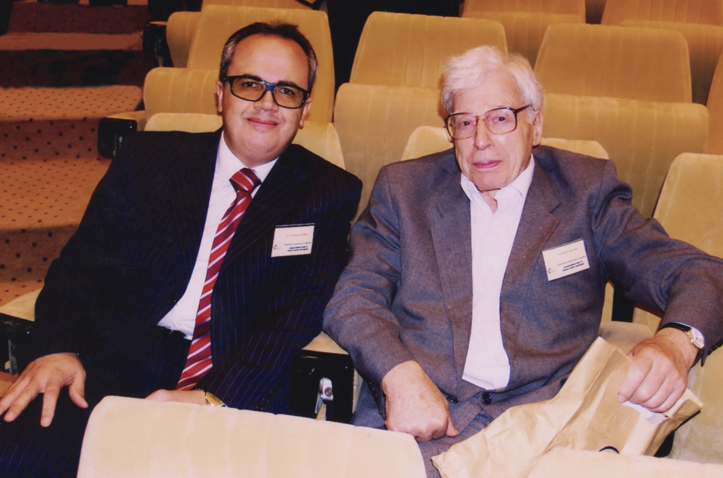

Slide 9
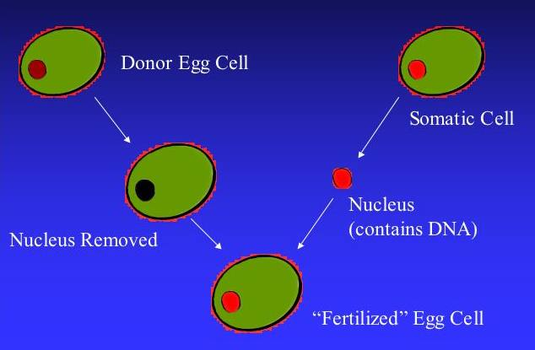
Cloning

Slide 10
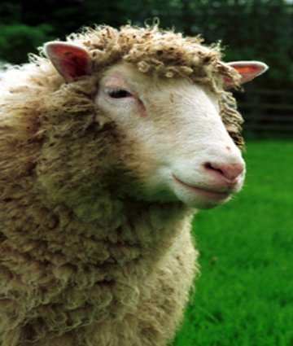
Dolly
1st experimentally cloned animal

Slide 11
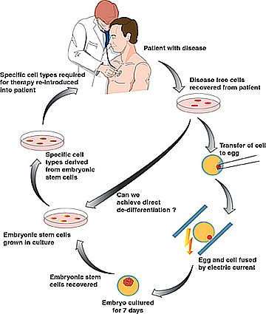
Therapeutic Cloning
2. Induce cells to develop into specific cell type that patient needs
1. Make embryonic stem cell line from patient

Slide 12
Cord Blood Banking
Duration – Under 5 minutes
Volume – 50 – 150 ml
Method – Gravity or syringe
Timing – After clamping of cord,
before or after delivery
of the placenta
Delivery – Vaginal or Caesarian

Slide 13
Acknowledgement
S. AL SAMAWI | MD. Gyn. Obs.
A. TAHA | MD. Gyn. Obs.
M. ABDUL WAHED | MD. Gyn. Obs.
J. SHARIF | Senior Biologist
N. ABO HASSAN | Androlgist
D. GHRAWI | Executive Secretary
N. OLABI | Presentation Design
F. HAMAD | Administration Manager
A. ALKHATEB | M.D Micro Biologist
R. ALKHATEB | MD. Gyn. Obs. Ph. D.

Slide 14
Thank You

Slide 15
Thank You

