Slide 1
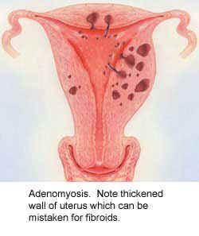
Adenomyosis
& infertility
Marwan Al-Halabi MD. PhD
Professor in Faculty of Medicine
Damascus - University
And
Medical Director
Orient Hospital
assisted Reproduction center
Damascus – Syria

Slide 2
Adenomyosis A Neglected Disease

Slide 3
Definition
Adenomyosis is a benign disease of the uterus characterized by ectopic endometrial glands and stroma within the myometrium
It is associated with myometrial hypertrophy and may be either diffuse or focal.

Slide 4
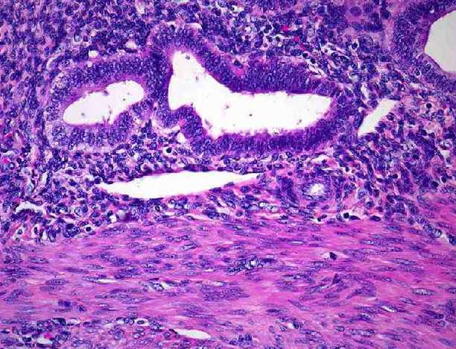
Definition

Slide 5
Definition
The gland tissue grows during the menstrual cycle and then at menses tries to slough, the old tissue and blood cannot escape
This trapping of the blood and tissue causes uterine pain in the form of monthly menstrual cramps.
It also produces abnormal uterine bleeding.

Slide 6
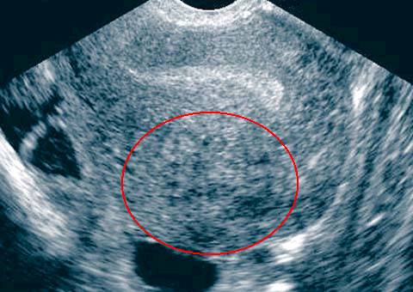
Definition of Adenomyosis
1- Presence
2- Depth Of Penetration
3- Degree Of Spread
4- Configuration of Lesions
(diffuse or nodular / Focal )

Slide 7
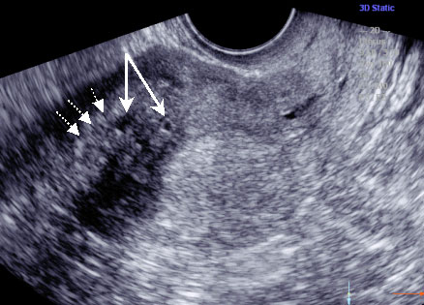
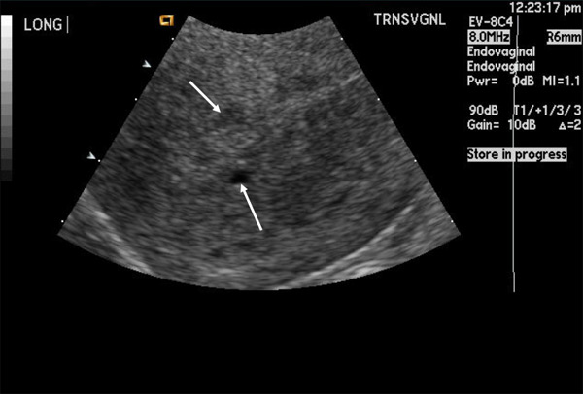
Grading of Adenomyosis
1- Superficial: inner myometrial third
2- Intermediate: Tow myometrial third
3- deep: Entire myometrical thickness

Slide 8
Adenomyosis: Epidemiology
About 1% of female patients
5 - 70% of hysterectomy specimens (Azziz 1989)
31% if 3 sections: 61% if 6 sections (Bird 1972)
More often in multiparous women
Fourth - fifth decade of life

Slide 9
Associated Factors
Over 23% of patients requiring hysterectomy for control of chronic severe pelvic pain had adenomyosis, and almost half of these women had had a tubal ligation performed. The possible relationship of adenomyosis to a previous tubal ligation has been explored.

Slide 10
Associated Factors
No relationship was found between age at surgery, age at menarche, indications for surgery, menopausal status at intervention, and presence of adenomyosis.But parity may be associated with an increased frequency of adenomyosis.

Slide 11
The typical symptoms include
Pelvic pain,
Dysmenorrhea,
And menorrhagia unresponsive to hormonal therapy or uterine curettage.
Dyspareunia
Subfertility.And pregnancy termination.
classic presentation
Cyclic, cramping uterine pain beginning later in reproductive life (generally after age 35) and often associated with prolonged and heavy menses

Slide 12
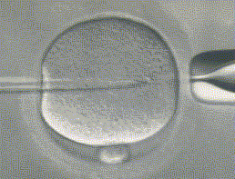
Adenomyosis
Possible Association with :
Infertility
Early Pregnancy Loss
Preterm Labor

Slide 13
2,616 consecutive hysterectomy specimens examined during a 7-year period.
Adenomyosis was noted in 16%
Multiparas between the ages of 30 and 50 years were most commonly affected.
Abnormal uterine bleeding was the common symptom
Myohyperplasia and leiomyomas were the usual associated lesions.
Aust N Z J Obstet Gynaecol 1988 Feb

Slide 14
Outcome of Hysterectomy for Pelvic Pain in 228 Premenopausal Women
Histopathological diagnosis:
Uterine leiomyoma (73.9%)
Uterine adenomyosis (40.4%)
Ovarian Cyst ( 9.3% )
Edometriosis ( 7.9% )
118 (51.8%) patients had a single pathology and 48.2% had multiple pathologies.
The agreement between operative clinical diagnosis and histopathological diagnosis was 57.1% for Uterine adenomyosis !
Tay sk, Bromwich N. (Aust N Z J Obstet Gynaecol. 1988 Feb;38 (1):72-6

Slide 15
Diagnosis First Step to Successful Therapy
Achieving the right diagnosis is probably the most important task of the physician!
- Without the right diagnosis the choice of treatment is inadequate and “guess work”.
- The right diagnosis allows the physician to present to the patient the choice of available treatments and to determine together the right therapy for the right patient – a prerequisite for success!

Slide 16
Diagnosis Major Problem of treatment of Adenomyosis
Differential diagnosis with a major and very common “other” uterine disease:
- uterine leiomyomas 35 – 55 % coexistence).
Knowledge and use of radiological diagnosis (TVUS, MRI) not yet routine.
Definitive diagnosis is in the hands of the pathologist!
- many diagnosis (post hysterectomy!)

Slide 17
Acknowledgement
S. AL SAMAWI | MD. Gyn. Obs.
A. TAHA | MD. Gyn. Obs.
M. ABDUL WAHED | MD. Gyn. Obs.
J. SHARIF | Senior Biologist
N. ABO HASSAN | Androlgist
D. GHRAWI | Executive Secretary
N. OLABI | Presentation Design
F. HAMAD | Administration Manager
A. ALKHATEB | M.D Micro Biologist
R. ALKHATEB | MD. Gyn. Obs. Ph. D.

Slide 18
Thank You

Slide 19
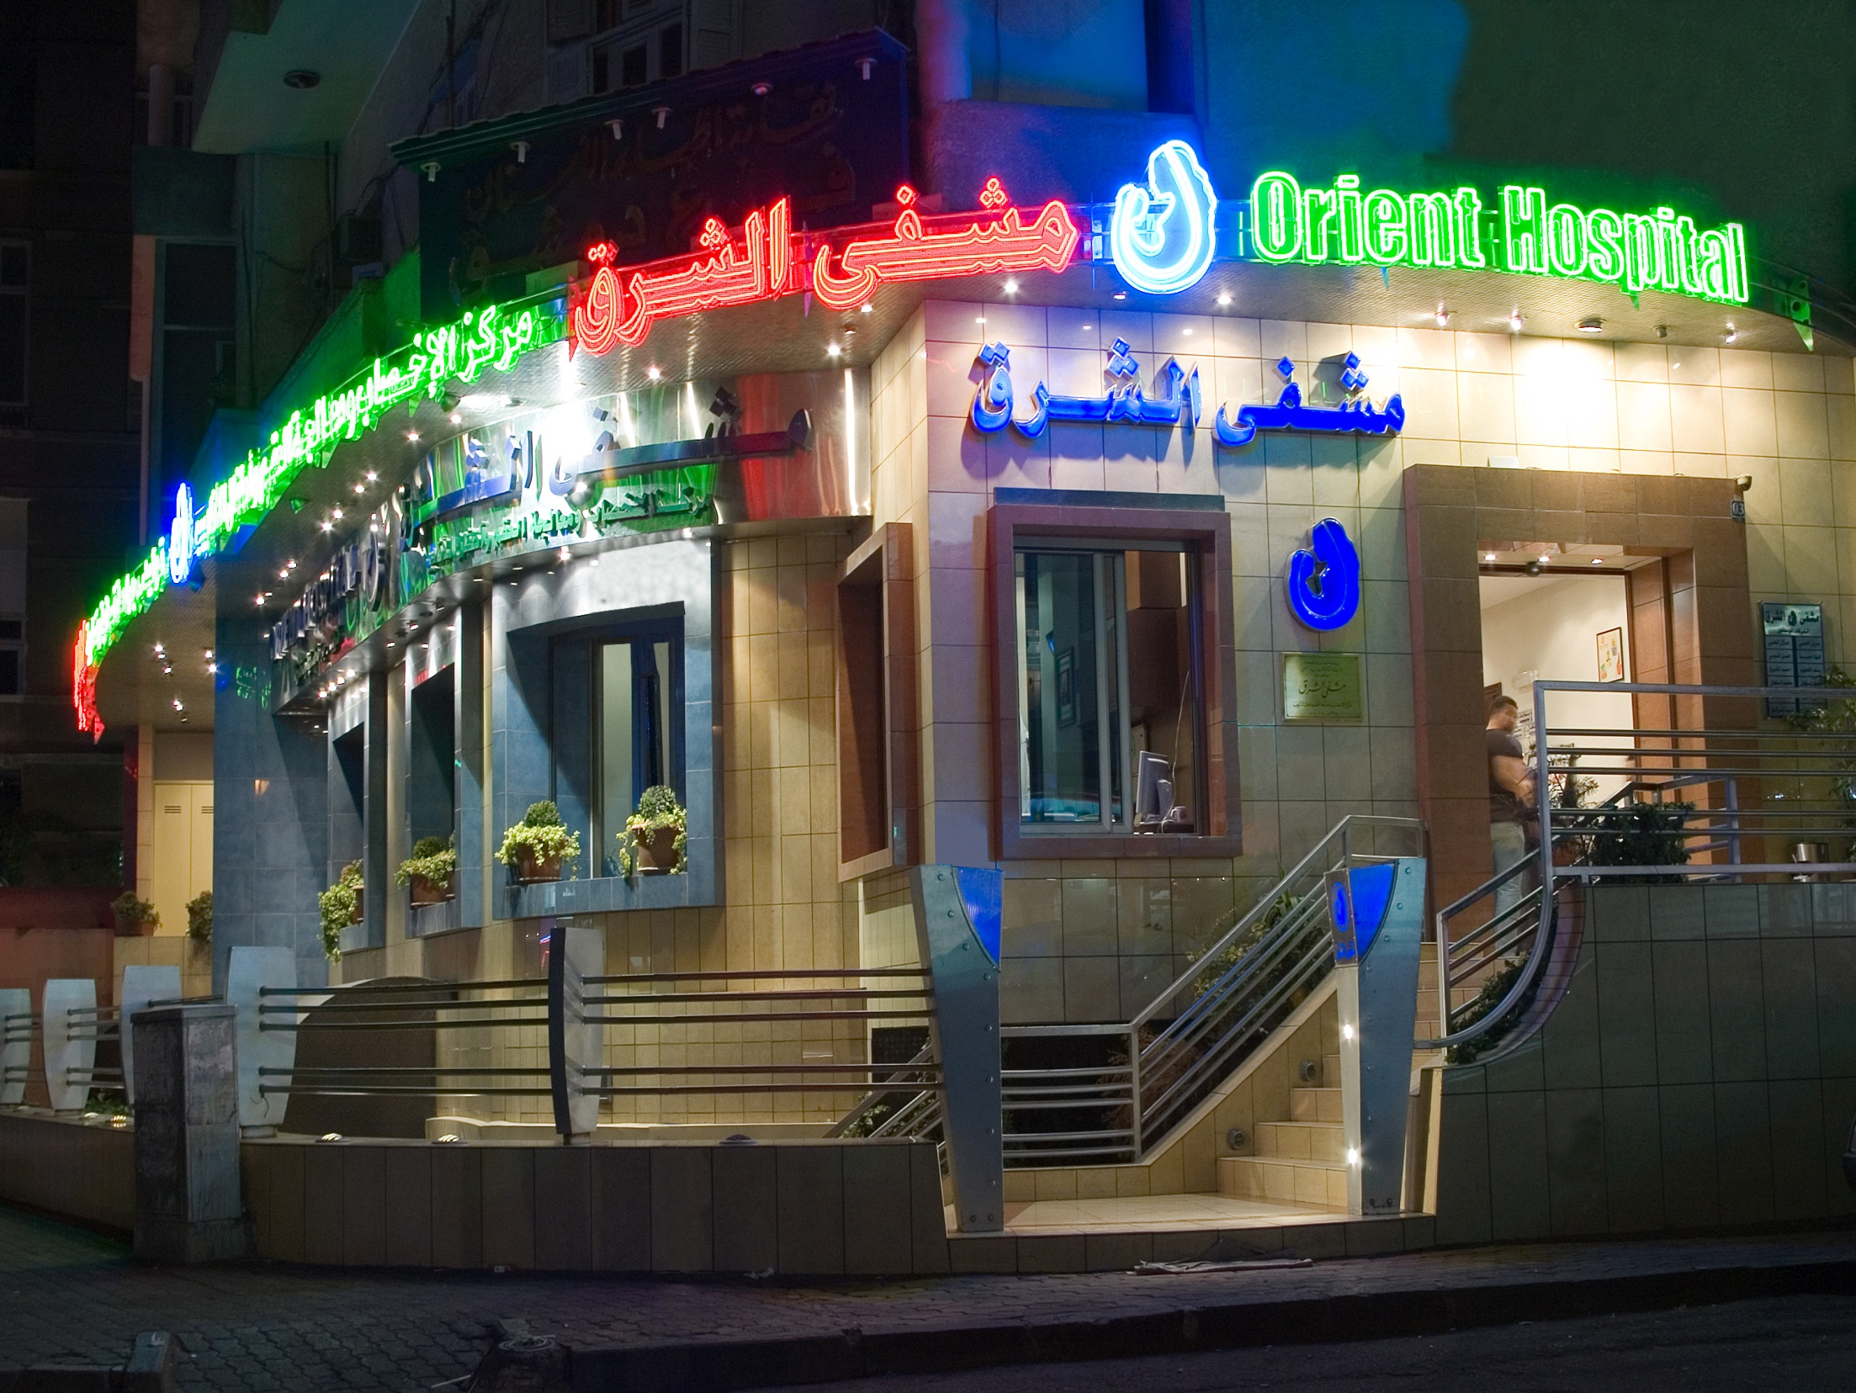
Thank You

