Slide 1
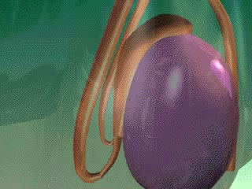
Non-Obstructive Azoospermia
Marwan Al-Halabi MD. PhD
Professor in Faculty of Medicine
Damascus - University
And
Medical Director
Orient Hospital
assisted Reproduction center

Slide 2
Azoospermia
Absence of sperm in ejaculate .
Azoospermia is present in about 8% of infertile males (WHO. 1997)
Diagnosis of azoospermia is made after examination of at least 2 semen samples obtained greater than 4 weeks apart .

Slide 3
Causes of Azoospermia
Pretesticular failure
Testicualr failure
Post-testicular failure

Slide 4
Pretesticular failure
  Genetic abnormality
    Kallmann’s syndrome
    Prader-Willi syndrome
    Cerebral ataxia with HH
  Idiopathic HH
  Isolated LH deficeincy
  Isolated FSH deficiency
  Prolactin excess

Slide 5
Testicular failure
Genetic abnormality
  Klinfelter’s syndrome: nonmosaic, mosaic
  XYY syndrome
  46 XX male syndrome
  Yq AZF gene deletion
Varicocele
Bilateral anorchism, cryptorchidism
Sertoli cell only syndrome
Gonadotoxin : drug, radiation, chemical
Orchitis

Slide 6
Evaluation
History
  Infertility : duration, pregnancy
  Developmental
  Medical, surgical
  Sexual
  Family
Physical exam.
Semen analysis
Endocrine test

Slide 7
Childhood and Developemental
Crytorchidism, testicualr torsion,
Mumps orchitis
Herniorrhaphy
Onset of puberty
Secondary sexual development
  Onset axillary, pubic hair, start of shaving
Onset of masturbation

Slide 8
Medical history
Medical history
  Systemic illness: hepatic, renal failure
  Gonadotoxins
    sulfasalazine, cimetidine, nitrofuratoin, chemotherapeutic, anabolic androgen
    Thermal injury
    Smoking, alcohol,marijuana
Surgical history
  Herniorrhaphy, badder neck, orchiectomy, retroperitoneal surgery

Slide 9
Physical examination
General appearance
Gynecomastia
Axillary, pubic hair
Testis volume, consistency
Epididymis induration
Varicocele
Digital rectal examination

Slide 10
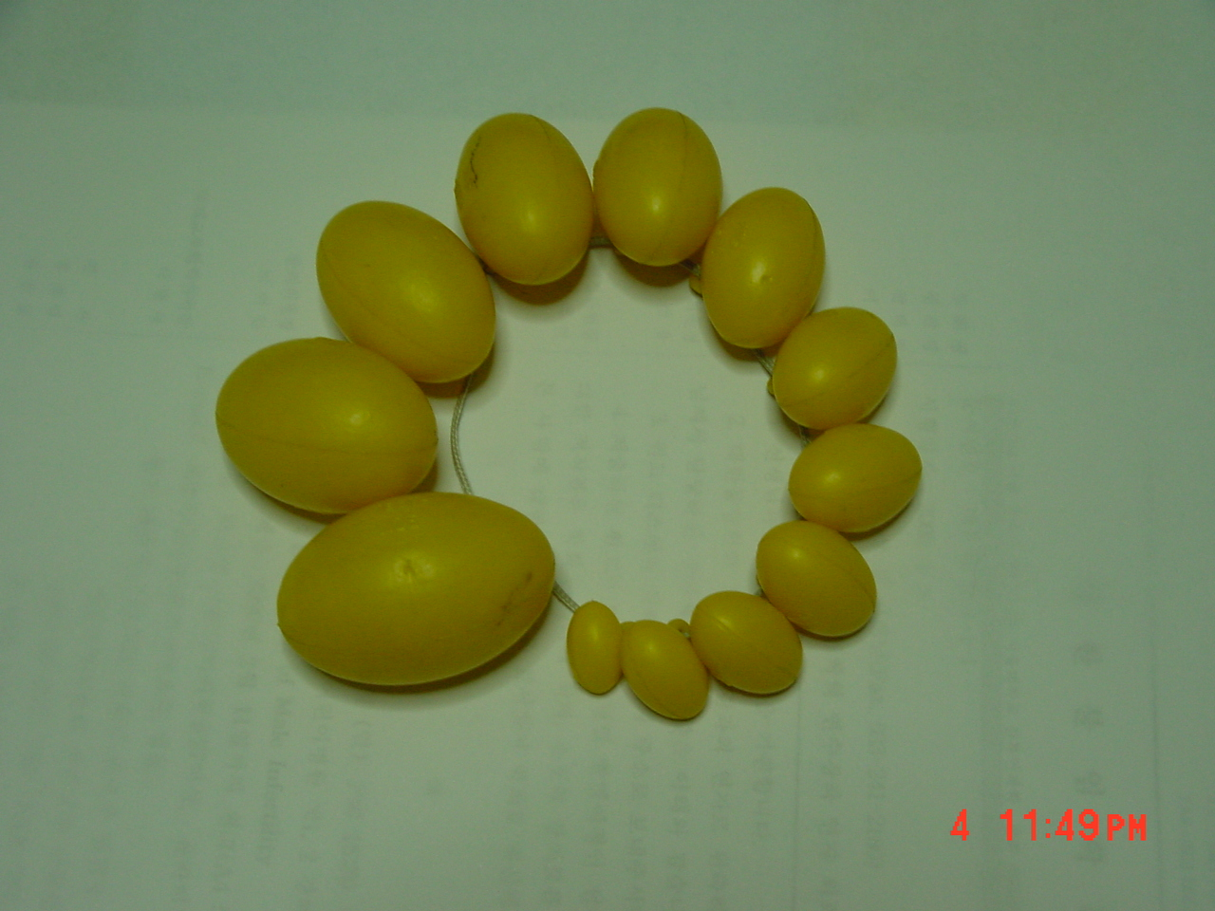

Slide 11
Semen analysis
At least 2 times analysis
Secretory azoospermia
  Pellet inspected after centrifugation at 1,500-2,000 rpm for 10min
If ejaculatory vol < 1ml
  Postejaculatory urine should be examined

Slide 12
Ultrasound examination
Scrotal US
  Testis volume
  Varicocele
  Testis tumor
Transrectal US
  Low volume azoospermia without absence of testicular atrophy
  Palpable abnormality on DRE

Slide 13
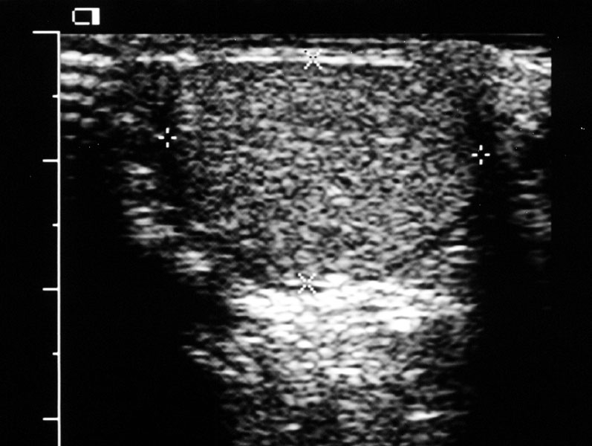
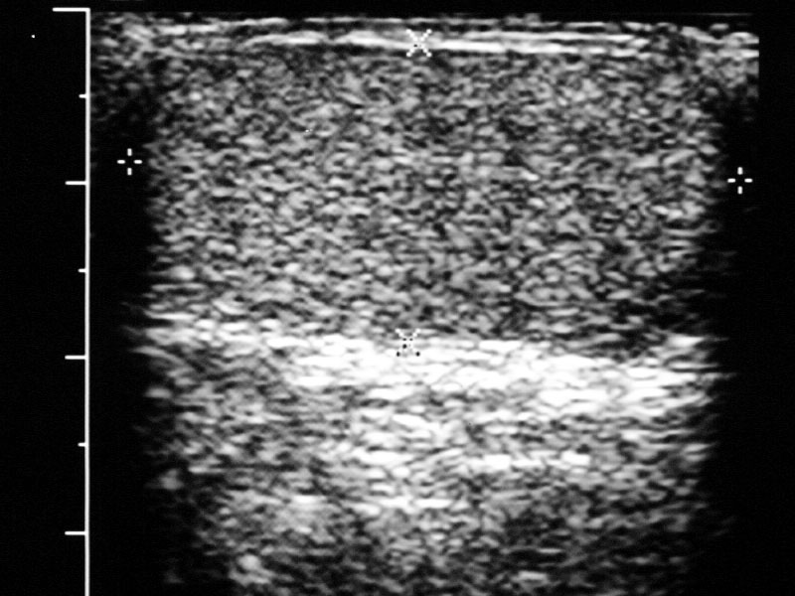
Volume(cc) = length x width x AP depth x 0.52

Slide 14
Hormonal status in clinical Dx
Clinical status | FSH | LH | T
Germ cell aplagia | ↑ | Normal | Normal
Testicualr failure | ↑ | ↑ | Normal or ↓
HH | ↓ | ↓ | ↓

Slide 15
Genetic evaluation of NOA
Sex chromosomal disorder
  Klinfelter’s syndrome(1/500) :15% of NOA
  XYY male(1/1,000), XX male(1/20,000)
Yq deletion : 10-20% of NOA
X-linked :
  Kallamann’s syndrome
  Androgen receptor deficiency
  Kennedy syndrome (spinal-bulabar muscular atrophy)
Autosomal defect
  Prader-Willi syndrome
  Androgen synthesis deficiency

Slide 16
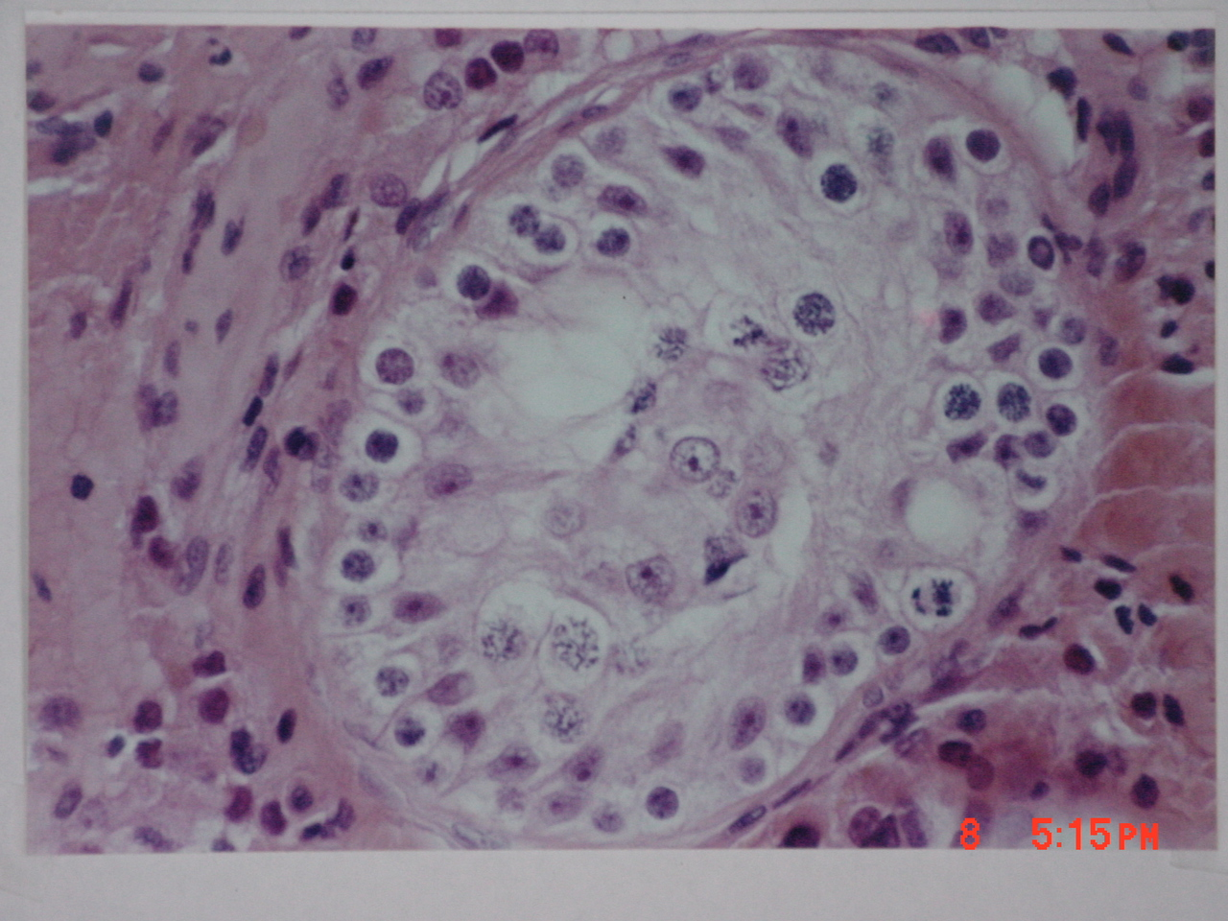

Slide 17
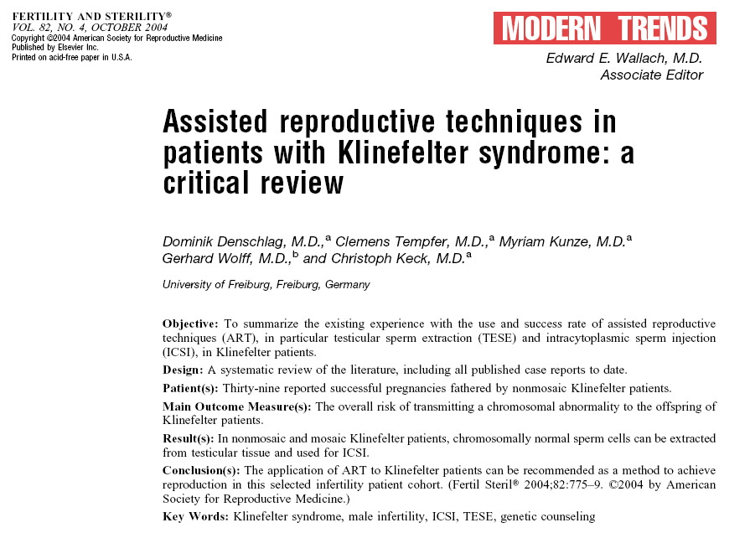

Slide 18
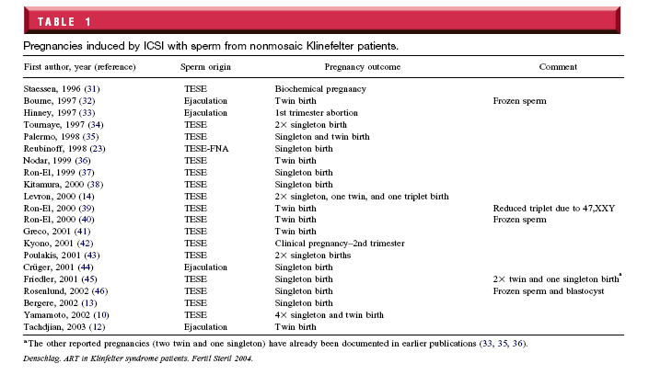

Slide 19
Klinefelter’s Syndrome and ICSI
 | Palermo | Halabi
Testicular Biopsies | 58 | 36
Sperm Recovered | 42 (72.4%) | 13 (36%)
Oocytes
Injected | 462 | 282
Fertilized | 259 (56.1%) | 105 (38%)
Deliveries | 18 (31%) | 1 (8%)
Children | 21 | 1

Slide 20
Origin of Sperm in Non-Mosaic 47,XXY (I)
XXY cell may enter and complete meiosis . Based on indirect evidence : presence of 24XX , 24XY spermatozoa in ejaculate potentially issued from XXY spermatogonia.

Slide 21
Origin of Sperm in Non-Mosaic 47,XXY (II)
Testicular mosaicism
Testicular sex chromosome mosaicism may owe its importance for spermatogenesis to the fact that XY rather than XXY cell lines enter meiosis

Slide 22
Kline Felter Syndrom:Summary
TESE and ICSI can be successful in non-mosaic Klinefelter’s patients.
The genetic risks resulting from injection of such spermatozoa should be discussed with each couple.

Slide 23
Y Chromosome Gene Deletions
Pseudoautosomal
1
2
3
4
5
6
centromere
AZFa region
AZFb region
AZFc region
Pseudoautosomal
Y chromosome

Slide 24
Genetics Counselling in Couples with Gene Deletion
Risk of transmitting microdeletion to their male offspring.
Pre-implantation genetic diagnosis (PGD) and gender selection (girl) as an alternative.

Slide 25
Genetics Counselling in Couples with Gene Deletion
General information regarding the association of spermatogenesis defects and Y microdeletions.
Treatment of microdeletion per se is not currently available.
Microdeletions do not always preclude the potential for treatment with testicular sperm extraction and ICSI.

Slide 26
Chromosomal Abnormalities in the Spermatozoa of 46,XY Males
Source | N | # of Cells Analyzed | Number of Sperm with (%)
 |  |  | Total Abnl | Nulli. | Autosome Disomy | Sex Chrom. Disomy | Diploid
Testicular (Non-Obst Azo)ª | 5 | 490 | 11.4 | 3.7 | 2 | 4.3 | 1.4
Epididymal (Obstr Azo)^{b} | 8 | 6,675 | 1.79 | 0.43 | 0.51 | 0.61 | 0.24
Ejaculated (Control | 14 | 25,150 | 1.56 | 0.27 | 0.51 | 0.45 | 0.33
Palermo et al Hum Reprod 2002; 17:570-5
a>b>c; P<0.00001

Slide 27
Sertoli Cell Only Syndrome SCOS
Tournaye et al, 2004 reported successful retrieval in :
86% of cases of in complete SCOS.
19% of cases of complete SCOS.

Slide 28
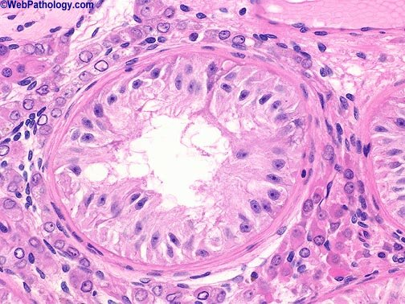
Sertoli Cell Only Syndrome ( SCOS )
There are islands of spermatogenesis in testicular pulp even in worst prognosis histological Conditions, Such as SCOS.

Slide 29
Treatment of NOA
Therapeutic challenge .
A variety of surgical and medical approaches have been used in attempts to improve the fertility potential in males with NOA.
- Varicocelectomy.
- Hormonal therapy.
- Clonidine therapy.
- Aromatase inhibitors.

Slide 30
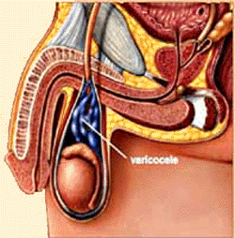
Varicocelectomy
Debate.
Some believe that most of these men still require TESE.
More recent work:
  -Improves sperm retrieval in TESE (North et al, 2005)
  -Return of sperm to the ejaculate (Pasqualotto et al, 2004)

Slide 31
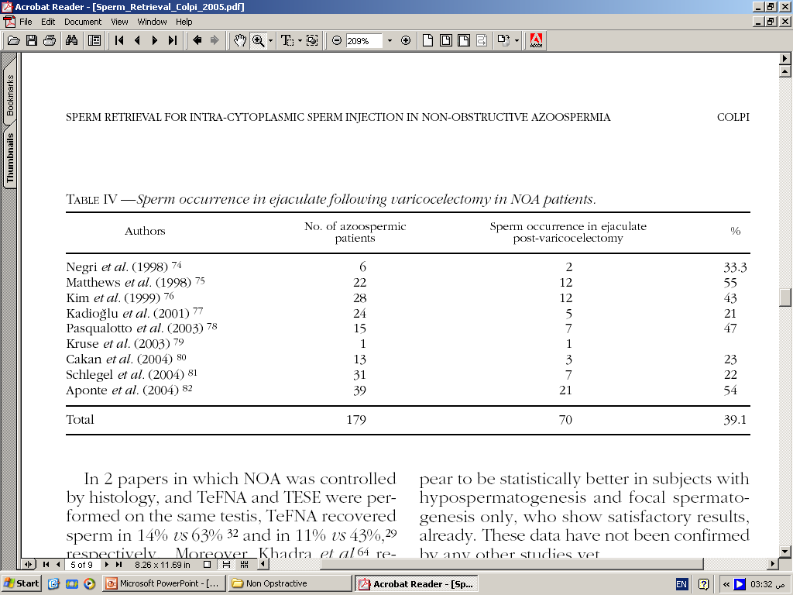
Varicocelectomy

Slide 32
Hormonal Therapy
Empiric treatment ⇒ ↑ Sperm Production
Recent works: FSH treatment before TESE improved sperm retrieval in :
  Normogonadotropic NOA patients (Aydos et al, 2005)
  Hypogonadotropic Hypogonadism (Fahmy et al, 2004)

Slide 33
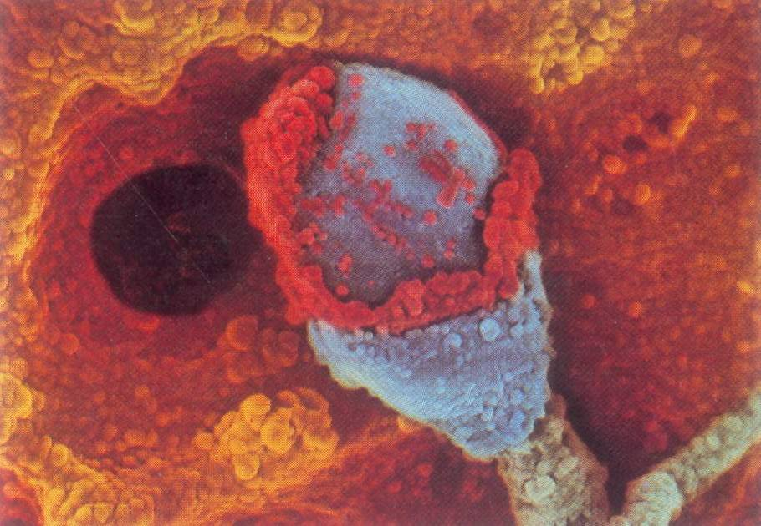
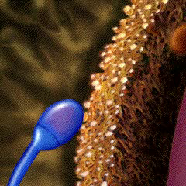
Hormonal Therapy

Slide 34
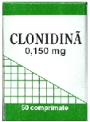
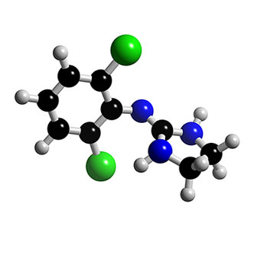
Clonidine Therapy
Partial GH ↓ Sptd arrest.
Clonidine ↑ GH.
Clonidine therapy:
  Return of sperm to ejaculate.
  Initiated pregnancy.

Slide 35
Aromatase Inhibitors
Some men with NOA → abnormal T/E2.
Aromatase inhibitors
(testolactone & anastrozole)
- Restore T/E2
- Return of sperm to
ejaculate (paviovich et al, 2004)
E2, P
Inhibin

Slide 36
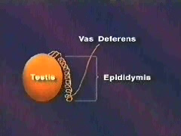
Medical & Surgical Treatment
No specific treatment is available.
Before TESE/ICSI:
- Treatment of correctable abnormalities
    Repair of large varicocele.
    Hormonal abnormalities.
    Avoidance of :
      – Exogenous androgens.
      – Gonadotoxins.
    3-6 months

Slide 37

Medical & Surgical Treatment
If female age is advanced, the benefit of treatment must be balanced against the rapidly declining female fertility potential

Slide 38
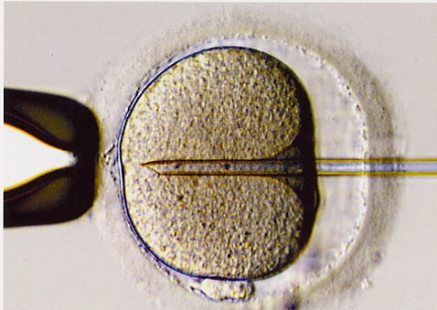
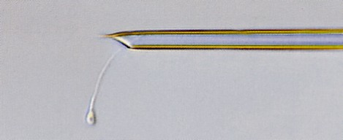
Intracytoplasmic Sperm Injection
ICSI ⇒ real advance in severe male factor infertility (Palermo et al, 1992)
Testicular sperm was used with success in NOA (Sllber et al, 1996)

Slide 39
Sperm Recovery Techniques

Slide 40
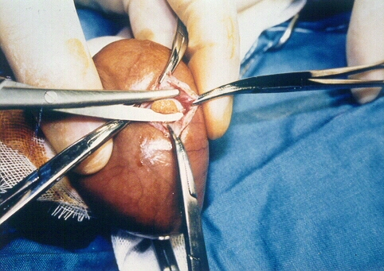
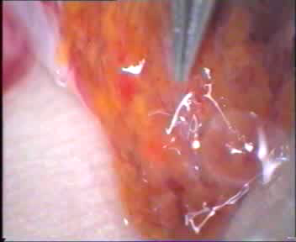
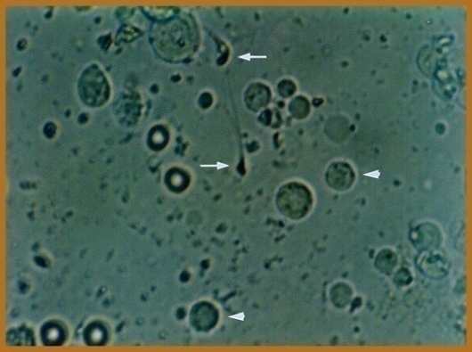
Testicular Sperm Extraction
(TESE)
Identification of vessels
Absence of sperm in one site doesn’t preclude the presence in others.
Multiple site TESE.

Slide 41
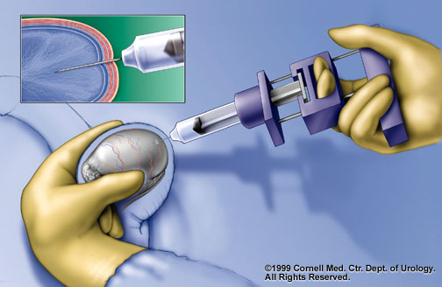
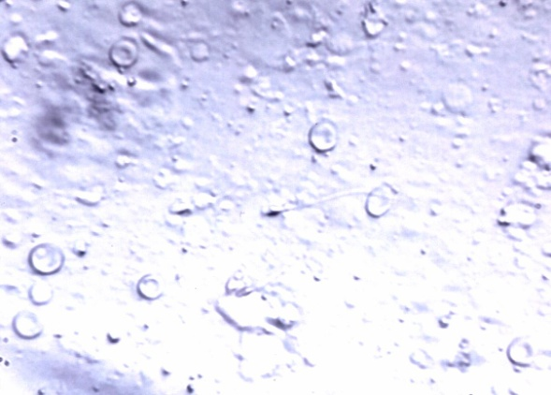
Fine Needle Aspiration
Less invasive recovery technique.
Decrease side effects of open TESE.
Results are comparable to open TESE in OA.
Less efficient than open TESE in NOA.

Slide 42
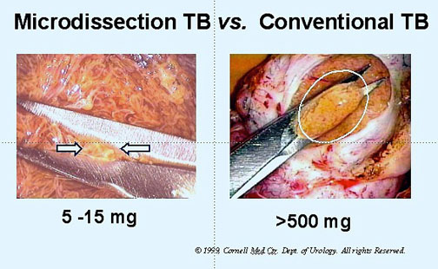
Microsurgical TESE
Proposed to minimize testicular damage
- ↑sperm recovery.
- ↓search time.
Open multiple
microsurgical TESE:
Recovery rate (50%) in NOA.

Slide 43
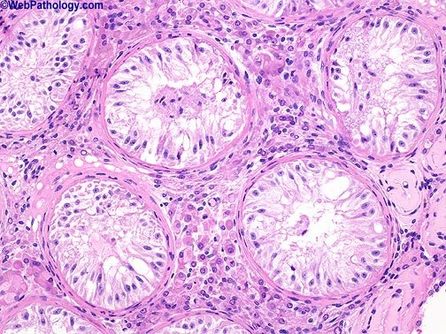
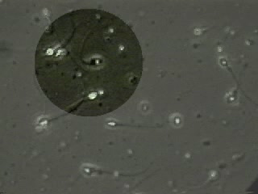
Classification of Testicular FNA
A1 : ( Sperm Count > 500 ) Obstructive
A2 : (Count > 300 ) Non Obstructive
B : Spermatid maturation arrest .
C : Sertoli cells only syndrome .
D : Sclerosis .

Slide 44
Adverse Effects of TESE
Infection.
Hematoma.
↑ ASA.
✵ Testosteron level
Recent works, Not signficant

Slide 45
Can a successful sperm recovery be predicted?
TESE ⇒ successful in 50%.
Adverse effects of TESE.
Unsuccessful TESE
  Emotional and financial implications.
  ✵
  Predictive factors are Important

Slide 46
Biochemical Markers
FSH
Inhibin – B
Anti-mullerian hormone
Total Testesteron
ILG-1
Nitrite & Nitrote
Stem cell factor
Others
FSH
Inhibin B
T. Testo

Slide 47
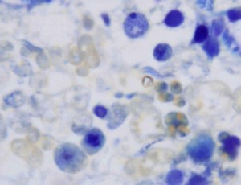
Predictive Factors
Round spermatid in semen (by MGG stain)

Slide 48
Genetic Markers
Y microdeletions, AZF a, b, c ⇒ different retrieval rate.
AZFa, b ⇒ poor.
AZFc ⇒ good.
1
2
3
4
5
6
DFFRY
DBY
UTY
AZFa
EIF1AY
PRY
TTY2
RBM1
AZFb
DAZ
BPY2
CDY1
AZFc

Slide 49
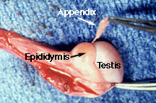
Predictive markers
No reliable predictive data are currently available.
Patients should not be excluded for TESE on the basis of clinical parameters
    Small testis size
    High FSH level
They should be told that there is a one to one chance of sperm recovery irrespective of the clinical situation

Slide 50
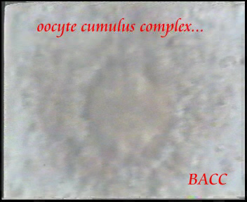
Outcome of ICSI using testicular sperm in NOA men
Based on the present data, couples may be counseled that their average chances of achieving delivery within two ICSI cycles with freshly retrieved sperm are 20% and after three cycles of more than 30% (Nicopullos et. al,.2004 ; Vernaeve et al,. 2005)

Slide 51
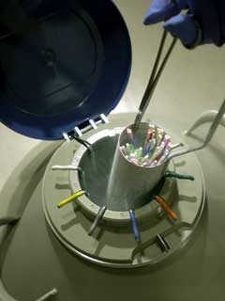
The use of Frozen-Thawed Sperm
Preliminary diagnostic TESE & cryopreservation is the procedure of choice in NOA.
Advantages :
- Avoid pointless ovarian
stimulation.
- Avoidance of repeated
testicular surgery.

Slide 52
Low Restrictive Criteria
In order to counteract the reasonable risk of not finding sperm or only immotile sperm, upon thawing, scheduling fresh surgery as back-up is advocated.
The use of totally immotile sperm after thawing should be discouraged.

Slide 53
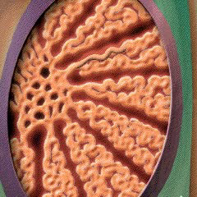
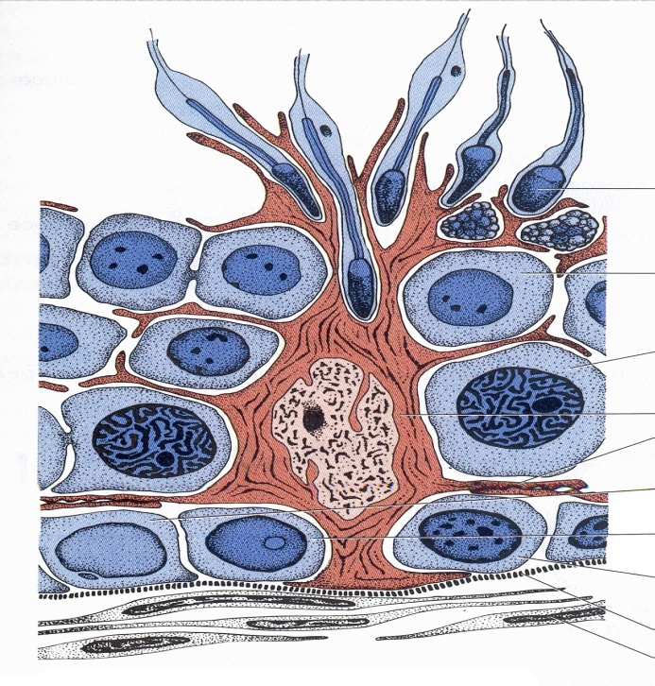
The Use of Immature Germ Cells
ICSI ⇒ spermatozoa or late elongated spermatid (up to Sd2 on Clermont classification)

Slide 54
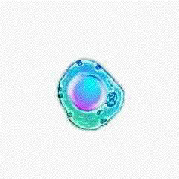
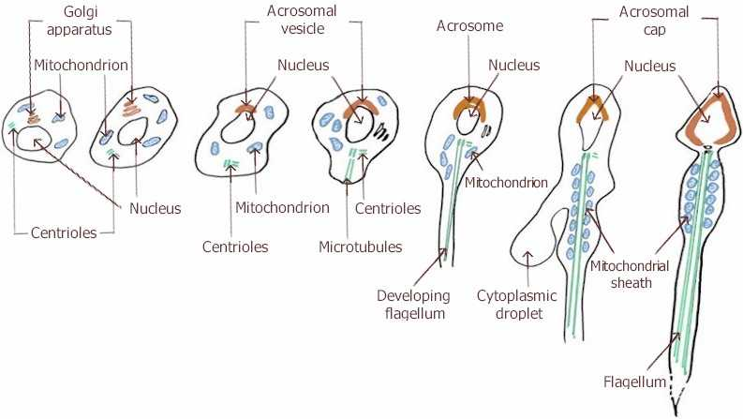
ART with Spermatids
ICSI using round spermatids has been proposed as a mean of overcoming sterility in men when no testicular sperm or elongated spermatids can be retrieved.

Slide 55
ART with Spermatids, Debate
Is there any target group?
It has been also postulated that genomic imprinting may be less complete when spermatids are used.
Since only few pregnancies have been reported ???

Slide 56
ART with Spermatids : conclusion
These Techniques are not successful approaches in treatment of NOA

Slide 57
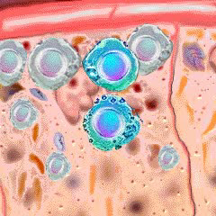
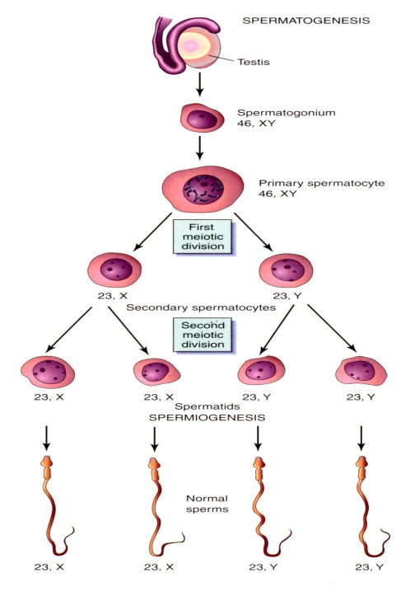
ART with Secondary Spermatocyte
A pregnancy has been reported after ICSI with secondary spermatocytes (Sofikitis et al., 1998)
However, this approach has never been confirmed.

Slide 58
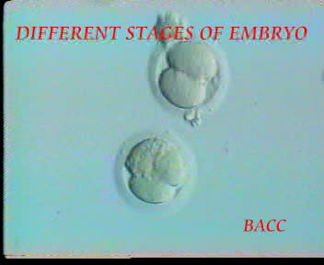
In-vitro Maturation of Germ Cells
There have been reports on the possibility of overcoming maturation arrest at C1 with the use in-vitro culture system.
Spermatogenesis was resumed and few atypical elongated spermatids were detected.
ICSI with the in-vitro developed elongated spermatids resulted in birth of two normal babies

Slide 59
In-vitro Maturation of Germ Cells
Concerns about the risk of
  Apoptotic DNA damage in developed germ cell.
  Chromosomal abnormalities of embryos.
  Incompleteness of genomic imprinting
  ↓
Based on these concerns
- Other groups have never reported this approach.
- Many authors consider this apporach as experimental (Tourraye, 2003 Vernaeve et al.,2005)

Slide 60
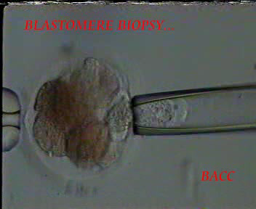
Preimplantation Genetic Diagnosis
PGD is a very early form of prenatal diagnosis
  Embryos are biopsied during culture in-vitro.
  Genetic diagnosis is carried out (PCR, FISH)
  Embryos shown to be free of the genetic disease are transferred to the mother.

Slide 61
Future Prospects
In the
Treatment of NOA

Slide 62
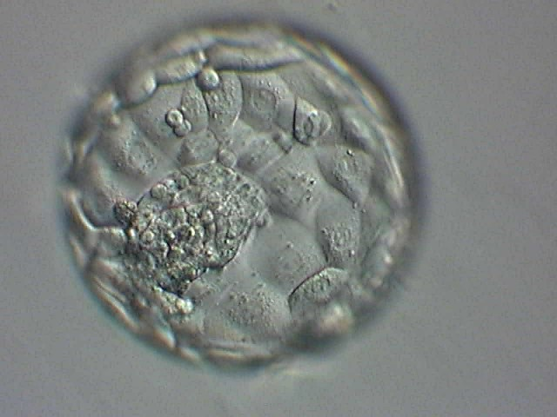
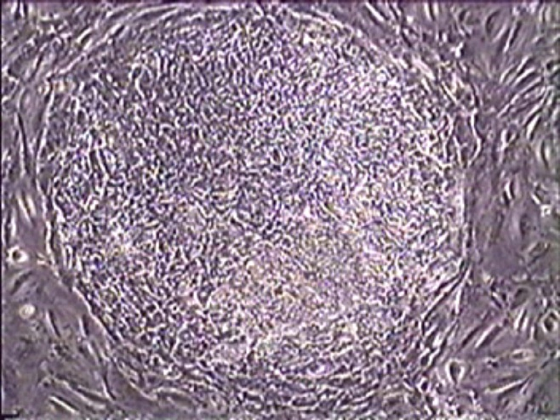
Embryonic Stem Cells
Trophectoderm
ICM

Slide 63
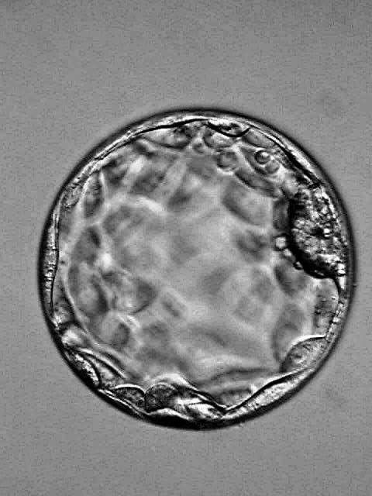
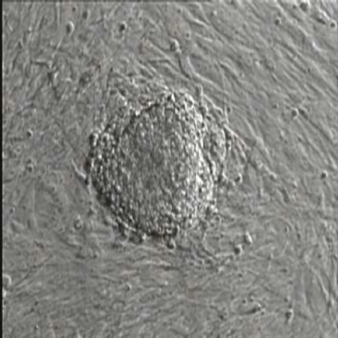
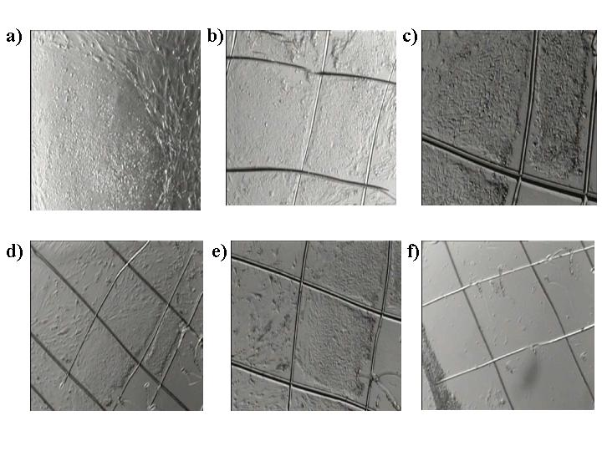
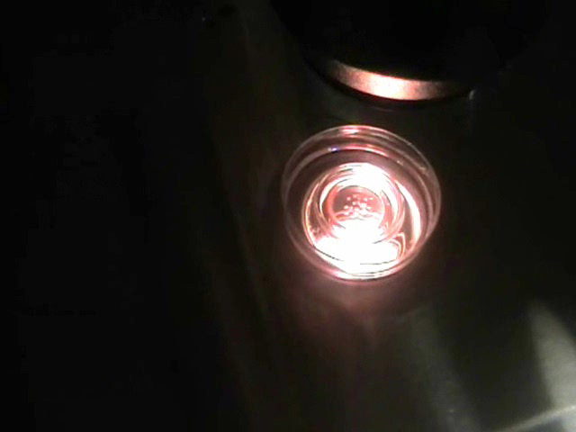
Human Embryonic Stem Cells
Feeder cells
hESC colony
ICM isolation
Culture
culture
Notes:
Laboratuvarımızda rutin iEK hücre kültüründe ICM izolasyonu için iki ayrı metod kullanılmkatadır. Bunlardan birinci olan immunocerrahi yönteminde trofoektoder guanine pig compleks ile işaretlenip parçalanarak ICM den uzaklaştırılır. Sıklıkla uyguladığımız ikinci yöntem olan direk kültürde ise zona pellücidası pronaz ile eritilmiş embryolar direkt olarak mitomisin ile aktivitesi sonlandırılmış destek dokusuyla kaplı petri ye alınır.

Slide 64
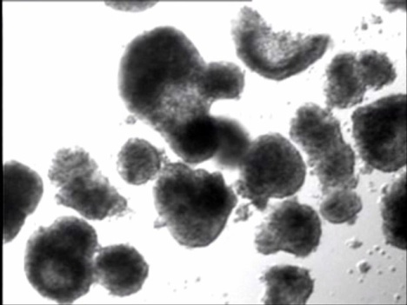
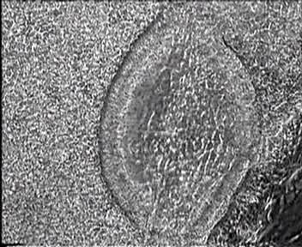
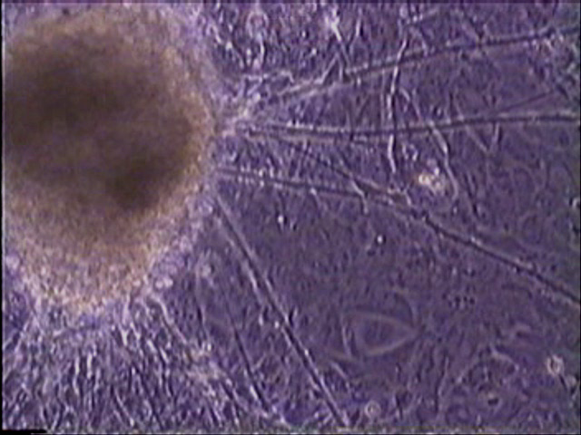
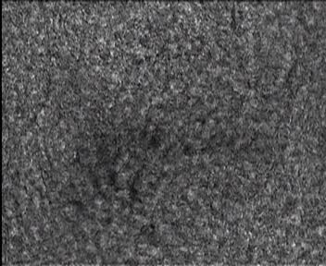
Human Embryonic Stem cells
mechanical passaging
Cystic EB formation
7-10 days of culture
Gelatin-coated dishes
(endoderm)
(ectoderm)
(mesoderm)
Notes:
iEKH karakterizasyonlarında bir de in vitro farklılşmadır. Bu amaçla mekanik olarak pasajlanan iEKH doku parçaları az yapışkan doku kaplarında süspansiyon içinde kültüre edilirler. Yaklaşık 10 günlük kültürlri sonucund akistik yuvarlak yapıya sahip EB ler jelatinle kaplı doku kaplarına transfer edilirler. Burada ki kültürleri esnasında hücreler yayılır ve farlı hücre tipleri gözlemlenir. Amaç 3 germ yapragına ait hücrelere farklılaştırmaktır.

Slide 65
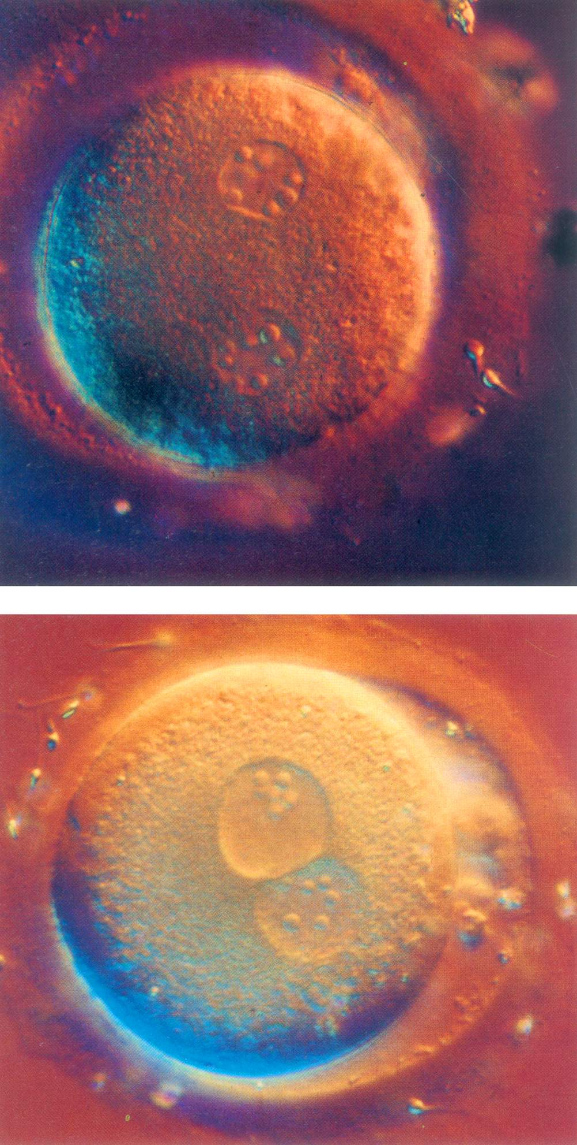
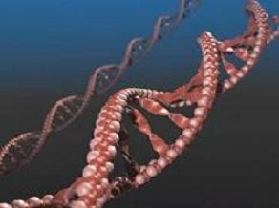
Somatic cell haploidization
Has been proposed as an experimental design to use somatic cell in substitution for the male gamete in cases with absent germ line (Tesarik, 2002; Tesarik and Mendoza, 2003)

Slide 66
Somatic Cell Haploidization
Hypothesis: patients’ somatic cell nuclei have to be introduced to a metaphase II oocyte leading to the formation of a triploid zygote, which is diploidized later leading to the formation of a diploid embryo.
This construct should be activated by entirely artificial means.

Slide 67
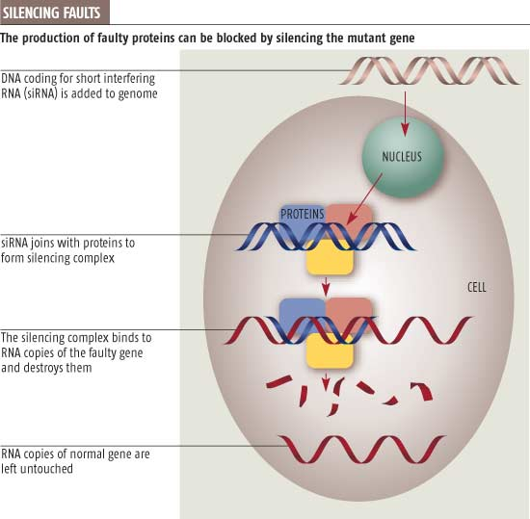

Somatic Cell Haploidization
Full data about this approach are still lacking.
Together with the enormous therapeutic potentials this approach might have in the future, this situation should encourage .
-further intensive research.
-open religious and ethical discussion.

Slide 68

Spermatogonial Stem Cell Transplantation
By the end of this decade 1 in 250 young men will be childhood cancer survival.
For these patients infertility has often been an accepted consequence of their life saving treatment.
Clinical application will involve pre-pubertal males facing systemic chemotherapy with sterilizing side effects

Slide 69
Testicular Transplantation
Pre –treatment testicular biopsy.
Isolation spermatogonial stem cell.
Cultured in-vitro.
Upon completion of treatment with no evidence of recurrence auto-transplantaion with their own cultured spermatogonia.
Subsequent repopulation of their testis with germinal tissue would result in spermatogenesis and fertility (Khaira et al., 2004)

Slide 70

Gene Therapy
Recently retroviral transduction of male germ line sperma-togonia has been reported and a prtential roadblock to gene therapy for male infertility has been overcome (Tenebaum et al,. 2005)

Slide 71
Conclusion
NOA may be a local presentation of systemic illnesses.
A complete careful evaluation is important for identification of etiology of male infertility which may open new approaches regarding prevention and treatment.

Slide 72
Conclusion
Although current medical management of NOA remains hindered by a lack of efficacious treatments, rapid advances in understanding the genetics of male infertility will most likely change this scenario in the years to come.

Slide 73
Conclusion
Just as the possibility of ICSI was thought to be inconceivable several decades ago, the advent of current and future discoveries will present the possibility for achievements that now seem incredulous

Slide 74
Acknowledgement
S. AL SAMAWI | MD. Gyn. Obs.
A. TAHA | MD. Gyn. Obs.
M. ABDUL WAHED | MD. Gyn. Obs.
J. SHARIF | Senior Biologist
N. ABO HASSAN | Androlgist
D. GHRAWI | Executive Secretary
N. OLABI | Presentation Design
F. HAMAD | Administration Manager
A. ALKHATEB | M.D Micro Biologist
R. ALKHATEB | MD. Gyn. Obs. Ph. D.

Slide 75

Thank You

