Slide 1
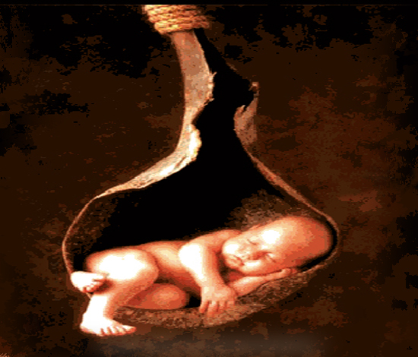
Thrombophilic & Immune Factors
Pregnancy Loss
Marwan Al-Halabi MD. PhD
Professor in Faculty of Medicine
Damascus - University
And
Medical Director
Orient Hospital
assisted Reproduction center

Slide 2
Recurrent Pregnancy Loss
Definition : 3 or more clinically recognized pregnancy losses before 20wks from LMP.
Clinical investigation should be started after two consecutive spontaneous abortions, especially
  when fetal heart activity had been identified prior to the pregnancy loss
  when the women is older than 35 yrs of age
  when the couple has had difficulty conceiving

Slide 3
Risk of Pregnancy Loss
15-20% of all Pregnancy
11-13% in a First Pregnancy
13-17% after one abortion
38% after Two abortions
ACOG: Testing after two Miscarriage.

Slide 4
Sub

Slide 5
Pregnancy loss
Spontaneous pregnancy loss is, in fact, the most common complicadon of pregnancy.
About 70% of human conceptions fail to achieve viability
estimated 50% are lost before the first missed menstrual period.
Most of preg. Losses are unrecognized.
Actual rate of preg. Loss after implantation is 31%(by hCG assay)
Clinically recognized, loss occures in 15 - 20% before 20wks of gestation.

Slide 6
Recurent
Miscarriage
Explained
Un-explained
Genetic
factors
Endocrine
Infective
agents
Enviromental
factors
Anatomical
factors
Immune
factors
Inhereted
Thrombophilic
defect
Bacterial
Vaginosis
Body
Cervix
C I
APS
Uterine
anomalies
Paternal
karyotyping
Cytogenetic
Of miscarriage

Slide 7
Causes of pregnancy loss
Chromosomal
55% of occult and early losses
5% of recurrent losses.
environmental
hormonal
anatomical
Immunological
45% of early losses
95% of late losses

Slide 8
Immune Factors
40% of unexplained Infertility.
80% of unexplained Pregnancy Losses.
Unfortunately for couples with immunological problems, their chances of recurrent loss increase with each successive pregnancy.

Slide 9
Immunological Factors
1) Auto – Immune :
Immunological response to pregnancy itself.
The woman is rejecting her own proteins .
Auto-antibodies attack own antigens.
2) Allo – Immune :
Mother’s response to the man’s genetic
contribution to the pregnancy
Rejection of proteins from the man

Slide 10
Classical Definition of The Immune System
- Innate Immune response .
    Macrophage
    Granulocyte
    They patrol and phagocytize foreign material .
Adaptive immune response .
    Cellular: cytolytic response by Natural Killer and cytotoxic T cells .
    Humoral: Antibody Production by cells

Slide 11
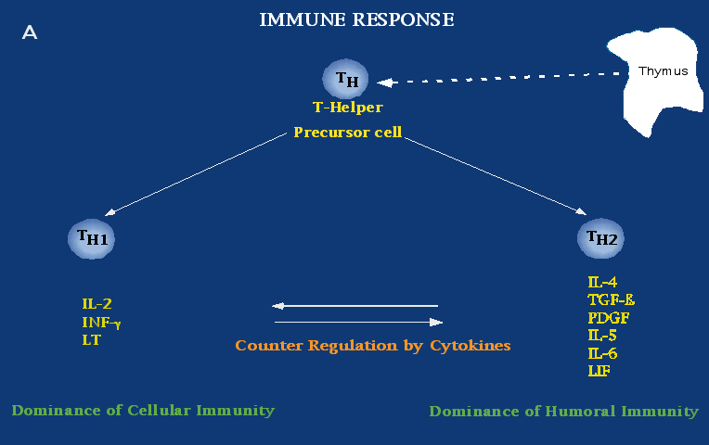

Slide 12
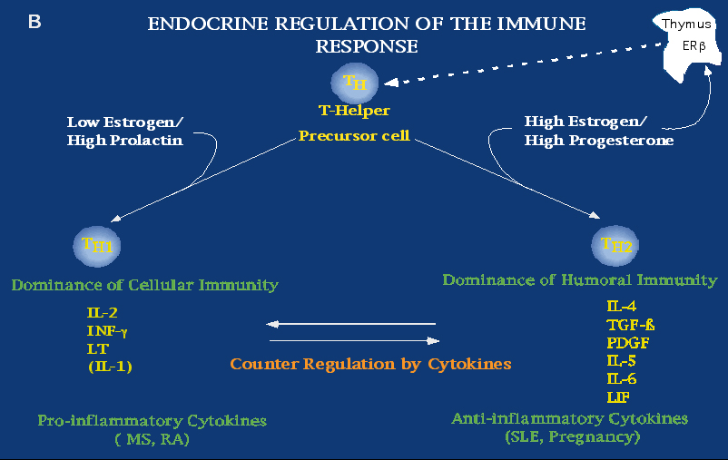

Slide 13
Adaptive immune response
T helper cells :
- TH1: Interferon gamma – to increases cell- mediated immune response and inhibits the humoral immune response.
- TH2: Interleukin 4- to increase humoral immune response and inhibits the cell mediated immune response.
Is highly specific and MHC dependent .

Slide 14
Immunology of Pregnancy
Mechanical Barrier .
Suppression of the maternal Immune System .
Absence of MHC class I molecules .
Th-2 type immune response
Local Immune suppression :
- Fas/Fas Ligand system .
- Macrophages and cytokines

Slide 15
Auto – Immune Factors
- Anti phospholipid antibodies (APL).
- Anti Thyroid antibodies (ATA)
- Anti Nuclear antibodies (ANA).

Slide 16
Antiphospholipid syndrome

Slide 17
Antiphospholipid Syndrome
In the antiphospholipid antibody syndrome the body recognizes phospholipids (part of a cell's membrane) as foreign and produces antibodies against them.

Slide 18
Antiphospholipid Syndrome
APA syndrome is an acquired autoimmune Factor in which vascular thrombosis and/or recurrent pregnancy losses occur in patients having laboratory evidence for antibodies against phospholipids or phospholipid-binding protein cofactors in their blood.

Slide 19
Antiphospholipid Syndrome
Antiphospholipid antibodies are a family of approximately 21 antibodies directed against negatively charged phospholipid binding proteins.
only the Lupus Anticoagulant and Anticardiolipin antibodies (IgG and IgM subclass, but not IgA) have been shown to be of clinical significance.

Slide 20
Antiphospholipid Syndrome
The mechanism of aPL-associated pregnancy loss is related to the adverse effect of these antibodies on:
embryonic implantation.
trophoblast function.
trophoblast differentiation.
placental vasculopathy.

Slide 21
Placental Vasculopathy
Placental pathologists use the term placental vasculopathy to describe pathological placental changes were found to be associated with some clinical conditions such as preeclampsia, IUGR, placental abruption and some cases of fetal loss and preterm labor .

Slide 22
Placental Vasculopathy
villous infarcts.
multiple infarcts.
fibrinoid necrosis of decidual vessels.
fetal stem vessel thrombosis.
placental hypoplasia.
spiral artery thrombosis .

Slide 23
PRINCIPAL PATHOGENIC MECHANISMS MEDIATED BY APL
Interference with:
protein C/S pathway inhibition; fibrinolysis inhibition | a) soluble coagulation factors:
induction of a pro-adhesive, pro-inflammatory and pro-coagulant endothelial phenotype; induction of a procoagulant phenotype in monocytes | b) coagulation cells:
reduction of proliferation and differentiation; gonadotrophin secretion impairment | c) trophoblast cells:

Slide 24
Antiphospholipid Syndrome
15-17 % from RPL ( in general ).
primary (53%)
secondary (47%) .
(37%) Secondary APS associated with SLE or SLE-like syndrome.
Females are more frequently affected than males. It mainly affects the second and third decades of life.
"Euro-Phospholipid Project Group". in a cohort of 1000 patients. Arthritis Rheum 2002;

Slide 25
Laboratory criteria
The laboratory criteria are medium or high titer, not low titer, IgG or IgM anticardiolipin antibody, and/or a lupus anticoagulant on two or more occasions at least six weeks apart.
Sapporo criteria ( RCOG )

Slide 26
Antiphospholipid syndrome
Adverse pregnancy outcomes include
(a) three or more consecutive miscarriages before ten weeks of gestation,
(b) one or more morphologically normal fetal deaths after the tenth week of gestation and
(c) one or more preterm births before the 34th week of gestation due to severe pre-eclampsia, eclampsia or placental insufficiency.

Slide 27
Anti Thyroid Antibodies (1)
30% From RPL.
Double risk for Pregnancy Loss or implantation failure (IVF)
Tow Kinds of Antibodies :
1- Thyroglobuline ( Anti TG ).
2- Thyroid microsomal ( Anti TPO).
  Seleniume , Prednisolone
  Thyroid Hormone Supplementation.

Slide 28
Anti Thyroid Antibodies (2)
  Aetiology :
    Link with other autoimmune problems.
    Direct involvement of the antibodies .
    Effect of age.
    Sub-clinical hypothyroidism .
    Natural killer cells hyperactivity .
    Marker for T-lymphocyte function.

Slide 29
Anti Nuclear Antibodies
Histones : Smallest building blocks of DNA.
ANA-Positivity : auto immune process that
affects the development of the placenta .
ANA-Positivity :
* SLE on lupus .
* Progressive Systemic Sclerosis .
* Sclerodermo Polymyositis .
* Drugs : Isoniazide, Hydralazin …
Idiopathic Mechanism .
Treatment : Prednisolone .

Slide 30
Allo-Immune Causes of RPL
Problems with embryo signaling .
    Soluble HLA-G.
Problem with maternal immune Response :
    NK cells.
    T cells (Th1 , Th2).
    B cells function.

Slide 31
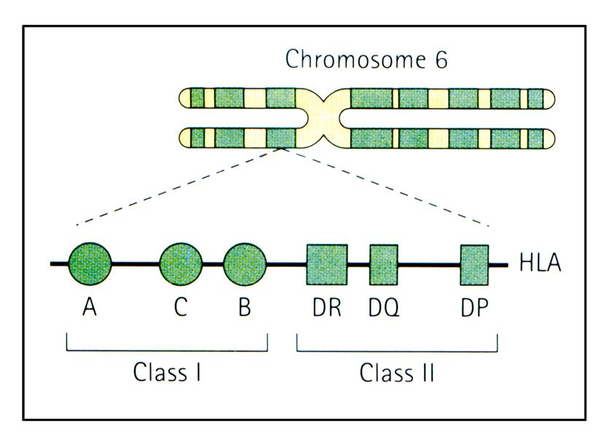
HLA - Genotyping
  HLA ( Human Leukocyte antigens ) , Class II .
  DQ Alpha Genotyping .
  Identify couples who look too much “alike”.
  Blocking antibodies deficiency.

Slide 32
Natural Killer Cells
  Immune cells witch kill anything perceived as foreign
  TNF ( tumor necrosis factor ), other cytokines
  * Like chemotherapy
  * embryo toxic
  NK Cells ( > 12% ) :
  High risk for abortion and Implantation Failure .
  The Test :
  RIP = Reproductive Immuno Phenotype ( CD 56 +).
  NK assay.
  Enbrel ( Etanercept ) Supress TNF Alpha
  Supress TH-1 Embryo – Toxic Cytokins

Slide 33
Embryo Toxicity
  Cytokines .
  Embryo Toxic Cytokines :
  - 60 % from RSA .
  - Endometriosis .
  The Test :
  ETA = Embryo Toxicity Assay

Slide 34
Thrombophilia

Slide 35
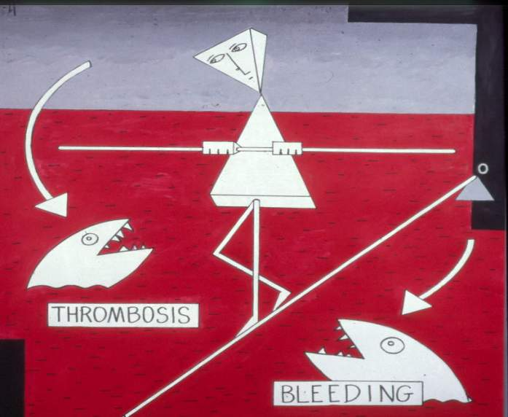
What is “thrombophilia”?
“Any disorder (inherited or acquired)
associated with increased
tendency to venous thrombosis “
Egeberg 1965

Slide 36
The contact between placenta and maternal circulation is crucial for the success of pregnancy.Pro-thrombotic changes and thrombosis may interfere with these processes leading to adverse pregnancy outcomes at any gestational age

Slide 37
Thrombophilia
Inherited
Actived Protein C resistance
Factor V Leiden.
Prothrombin Mutation.
(MTHFR) Hyperhomocystenemia.
Protein C deficiency
Protein S deficiency
Anti Thrombin deficiency
Acquired
Antiphospholipid synd
Advancing age
Malignancy
Immobilization
Trauma, Postoperative
Pregnancy
Estrogen use
Hematologic diseases
Nephrotic syndrome
Combined:
Hyperhomocystenemia

Slide 38
Inherited
Thrombophilia

Slide 39
Factor V Leiden - APC Resistence
APCR results from a point mutation in the FV gene, which causes resistance to degradation by activated PC (AD)
The partial resistance of the mutant factor Va to inactivation by PC causes half life of FVa to prolonged, and the hemostatic balance to shift toward thrombosis
Most common inherited thrombophilia,
5-8% of healthy general population,
20-30% of patients with thrombosis
Thrombotic risk x7 in heterozygotes
x80 in homozygotes
Common with other types of thrombophilia

Slide 40
Activated Protein C Resistance
Factor V Leiden is the cause of APCR in95% of cases
Other Causes: (5%)
Pregnancy
Oral contraceptives
Increased levels of factor VIII
Anti phospholipid antibodies
cancer
Other mutations in factor V

Slide 41
Factor V Leiden (A506G) mutation
adenine 506 guanine (A506G) mutation in factor V (factor V Leiden) (a substitution of glutamine for arginine at amino acid 506 of factor V) Factor V Leiden (FVL) is a mutation in the factor V molecule, rendering it resistant to cleavage by activated protein C. Factor V remains a procoagulant and thus predisposes the carrier to clot formation.
It has been linked with an increased risk for venous thromboembolism due to Resistance to activated protein C and is responsible of 20–30% of venous thromboembolism events

Slide 42
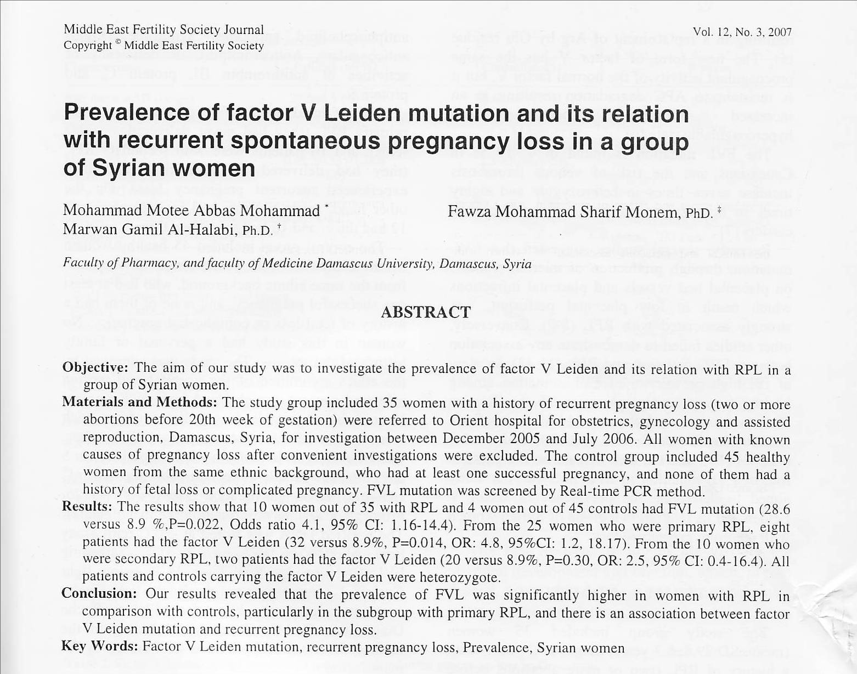

Slide 43
Prothrombin (G20210A) mutation
A change of G to A at position 20210 in prothrombin (prothrombin 20210A) elevates baseline prothrombin levels and thrombin formation.

Slide 44
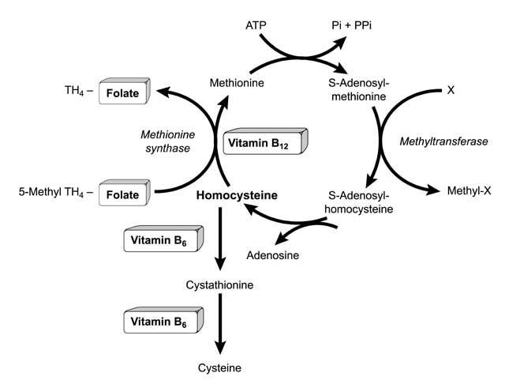
Hyperhomocystinemia
Homocysteine-
intermediary amino acid
formed by the conversion of methionine to cysteine
Cofactors: folate, vitamin B12,
vitamin B6

Slide 45
Hyperhomocysteinaemia
Reduced activity of MTHFR
homozygous for mutation C677T
Deficiencies of folate, vitamin B6, vitamin B12
Increased risk of thromboembolic disease: meta-analysis OR 2.95 (CI 2.08-4.17)

Slide 46
Methylene tetrahydrofolate reductase (MTHFR)
Most common form of genetic hyperhomocysteinemia
Point mutation- alanine-valine aa677 reduced enzymatic activity
Homozygotes- increased homocysteine levels (10% of normal population), confers a x2-3 increased
risk for thrombosis
Risk factor for atherosclerotic disease and
recurrent VTE
Heterozygotes- normal homocysteine levels, no increased risk for thrombosis

Slide 47
MTHFR (C677T) mutation
A homozygous methylenetetrahydrofolate reductase (MTHFR) mutation, present in 1-4% of the general population, is associated with a three fold increased risk for DVT or PE, as well as preeclampsia and placental abruption.

Slide 48
Protein S deficiency
Protein S deficiency (PSD), present in up to:
2 % of the general population, is found in approximately
15% of individuals with a DVT or PE.
6% of women with obstetrical complications.
including a relatively high risk for stillbirth.

Slide 49
Protein C deficiency
Protein C deficiency (PCD), present in about 1.5% of the general population, is associated with a lower risk for obstetrical complications than PSD and is found in 3-5% of individuals with a DVT or PE.
Furthermore, PCD combined with a FVL mutation is a relatively common cause of DVTs and show a higher risk for thrombosis compared to FVL alone.

Slide 50
Antithrombin III deficiency
Antithrombin III deficiency (ATIII), present in less than 0.5 % of the general population, as with PSD and PCD, may rarely result from mutational events
Because of its relative rarity, actual risks for thrombotic events are difficult to estimate, but without question this entity contributes to thrombotic risks during pregnancy.

Slide 51
Changes in Normal Pregnancy
Protein S: free levels fall to 40%-60% of normal in the first trimester
Protein S deficiency requires confirmation 3 months post partum
Protein C: constant in all 3 trimesters
Antithrombin: unchanged by pregnancy but can fall in severe pre-eclampsia
Homocysteine: falls by 30%-50%
Prothrombin levels increase

Slide 52
Prevention

Slide 53
In the past the obstetrical art focused mainly on how to deal with complications.
but now by the remarkable advance in modern obstetrics ,immunology, and hematology, the goal is how to prevent them.

Slide 54
Maternal risk assessment
Maternal risk assessment can be firstly identified from
history

Slide 55
Maternal risk assessment
Recurrent pregnancy loss is not just a Bad Luck and must be investigated .

Slide 56
Maternal risk assessment
But on other hand some conditions need no recurrence to be alarming, and to be investigated.

Slide 57
one unexplained fetal deaths after ten weeks of pregnancy
any of these must
invite
a big question mark
one preeclampsia or placental insufficiencies occurring before 34 weeks
?
One previous preterm birth
one or more confirmed episodes of venous or arterial thrombosis.

Slide 58
Pregnancy loss after 10wk
one pregnancy loss more than 10wk. Gestation or pregnancy associated with late adverse outcome
need no recurrence to be investigated.

Slide 59
Pregnancy loss after 10wk
94.5%
3%
2%
0.5%
& thrombophilic

Slide 60
Pregnancy Loss after 10wk
How much is thrombophilia common among general population
?

Slide 61
Inherited thrombophilia
%

Slide 62
Thrombophilia and fetal loss
Recent case-control studies and meta analyses attempted to quantify the risks associated with different thrombophilic defects and adverse clinical events in pregnancy,

Slide 63
Thrombophilia and fetal loss
A meta analysis published in LANCET 15 march 2003 included 31 studies published between 1975 and 2002 (by Medline search).

Slide 64
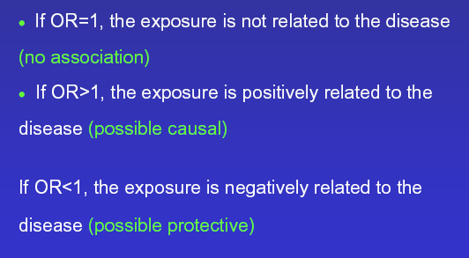
Relative risk is quantified by odd ratio

Slide 65
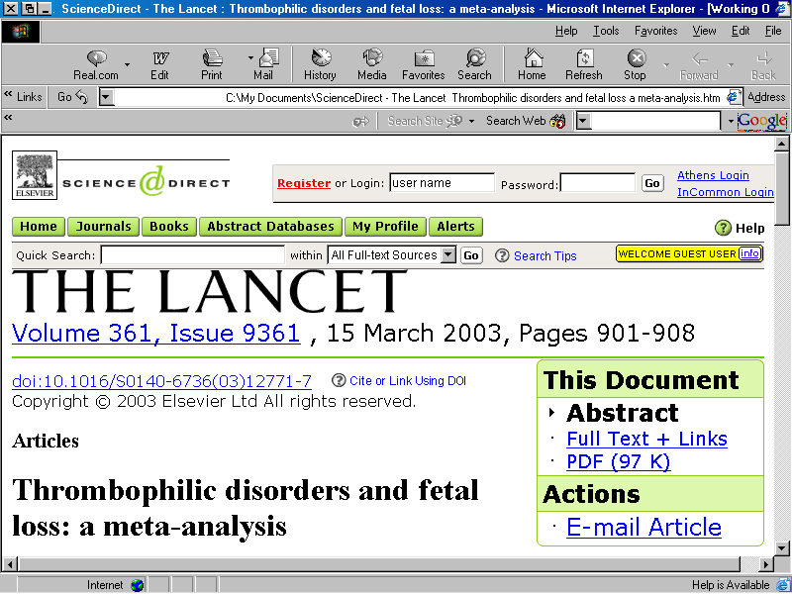

Slide 66
Thrombophilia and fetal loss
Odd ratio
Odd ratio

Slide 67
Thrombophilia and fetal loss
Odd ratio

Slide 68
Assessment of maternal risk and prediction of risk factors is the gate for prevention of adverse pregnancy outcomes.

Slide 69
Management

Slide 70
Antiphospholipid Antibodies
In women with a history of recurrent miscarriage and aPL, future live birth rate is significantly improved when a combination therapy of aspirin plus heparin is prescribed.
( RCOG-A)

Slide 71
Antiphospholipid Antibodies
Currently there is no reliable evidence to show that steroids improve the live birth rate of women with recurrent miscarriage associated with aPL.
their use may provoke significant maternal and fetal morbidity.
( RCOG-C)

Slide 72
Antiphospholipid Antibodies
Pregnancies associated with aPL treated with aspirin and heparin remain at high risk of complications during all three trimesters.
( RCOG-B)

Slide 73
Thrombophilias
The combination of aspirin and heparin is effective in recurrent fetal loss in APS and could be considered for women with inherited thrombophilias and history of severe preeclampsia, IUGR, abruptio placentae or fetal loss, although no controlled studies on the subject are currently available
Cochrane Review 2003

Slide 74
Anti-thyroid Antibodies
Routine screening for thyroid antibodies in women with recurrent miscarriage is not recommended.
( RCOG-B)

Slide 75
Alloimmune factors
Immunotherapy, including paternal cell immunisation, third-party donor, trophoblast membranes and intravenous immunoglobulin (IVIG), in women with previous unexplained recurrent miscarriage does not improve the live birth rate
( RCOG-B)

Slide 77
Acknowledgement
S. AL SAMAWI | MD. Gyn. Obs.
A. TAHA | MD. Gyn. Obs.
M. ABDUL WAHED | MD. Gyn. Obs.
J. SHARIF | Senior Biologist
N. ABO HASSAN | Androlgist
D. GHRAWI | Executive Secretary
N. OLABI | Presentation Design
F. HAMAD | Administration Manager
A. ALKHATEB | M.D Micro Biologist
R. ALKHATEB | MD. Gyn. Obs. Ph. D.

Slide 78

Thank You

